Slide 1
How to Assess Three-Dimensional Learning in Your Classroom: Building Assessment Tasks that Work
Shelley Stromholt
Philip Bell
University of Washington
Tiffany Neill
Sam Shaw
Council of State Science Supervisors
Katie Van Horne
Bill Penuel
University of Colorado Boulder
January 2017 • Resource B
This work is licensed under a Creative Commons Attribution-ShareAlike 4.0 Unported License. Educators and others may use or adapt. If modified, please attribute and re-title. CC BY-SA license details are at https://creativecommons.org/licenses/by-sa/4.0/

Slide 2
Overview of the Session
Develop a shared understanding of the 3D Assessment Design Challenge
Analyze assessment tasks for “3D-ness”
Explore tools for designing 3D assessments
Task Formats for Science & Engineering Practices
Prompts for Cross-cutting Concepts
STEM Teaching Tool 33
Other STEM Teaching Tools: #26 and #29
Adapt an existing task for “3D-ness” and accessibility
Notes:
There is a growing set of examples of assessments completely aligned to the 3D model of learning in the NRC Framework and NGSS. Still, people will need to adapt the ones that exist or create new ones. Performance expectations also underspecify the nature of evidence needed to draw inferences about student learning. This workshop highlights the role of formative assessment in the classroom and aims to help participants identify assessment components that focus on individual practices, core ideas, or crosscutting concepts, and understand how, taken together, the components can support inferences about students’ three-dimensional science learning as described in a given performance expectation or bundle.
There are four activities in this session… ((Read Slide))
[estimated time: 2 min]

Slide 3
Background Resources
Notes:
There are some background resources that fit well with this PD session…
[estimated time: 15 sec]

Slide 4
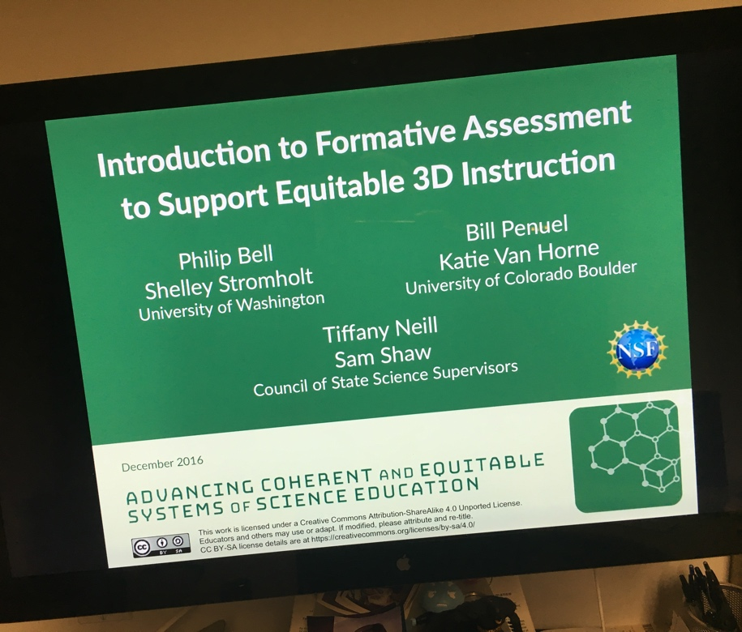
Prerequisite PD Module
stemteachingtools.org/pd/SessionA
tinyurl.com/3Dassessmentdevelopment
Notes:
The ACESSE project has an hour-long introduction to formative assessment in science education PD session, shown on the left, that ideally functions as a prerequisite for this session. It provides a shared definition for formative assessment, highlights different kinds of formative assessment, and describes important components and implementation ideas.
As shown on the right, the STEM Teaching Tools site provides an online short course on 3D assessment that goes into significantly more detail about the kind of work we are doing today—and it links off to a set of helpful professional learning resources related to 3D assessment and instruction.
[estimated time: 1 min]

Slide 5
Overview of the 3D Assessment Challenge
Notes:
So, let’s dive in…
[estimated time: 15 sec]

Slide 6
Challenges of Developing 3D Assessments
How can we assess “three-dimensional learning”?
How is it different from how we assess science learning now?
How can we design tasks that elicit disciplinary core ideas, practices, and crosscutting concepts?
Notes:
((Read Slide))
The 3D learning model in the NRC Framework comes from a synthesis of the research literature that studied how best to support equitable student learning in science (e.g., through powerful instruction), but educational assessments haven’t historically been developed for a 3D model of learning. New approaches are being developed and studied—like those that we will be exploring today.
[estimated time: 30 sec]

Slide 7
Multi-Component Tasks
To adequately cover the three dimensions, assessment tasks will need to contain multiple components (e.g., a set of interrelated questions).
Specific components may focus on individual practices, core ideas, or crosscutting concepts, but, together, the components need to support inferences about students’ three-dimensional science learning as described in a given performance expectation.
Notes:
The National Academy of Science published a consensus report outlining the assessment issues and strategies associated with the 3D learning model in the NRC Framework.
One assessment model they highlight is the use of multi-component tasks—that is, a set of questions students answer related to a common scenario or situation.
((Read Slide))
https://nap.nationalacademies.org/catalog/18409/developing-assessments-for-the-next-generation-science-standards
[estimated time: 1 min]

Slide 8
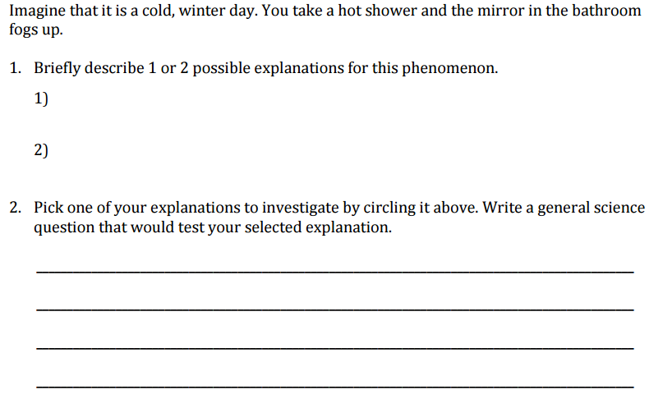
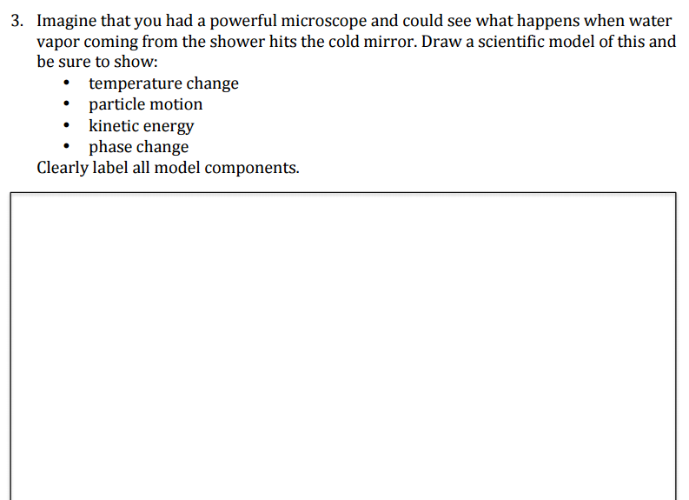
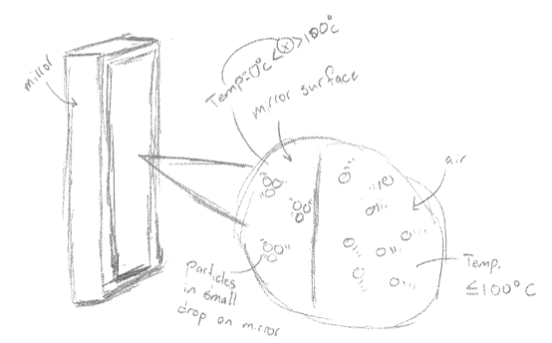
Sample Classroom Assessment: How can you explain a fogged mirror?
Assesses aspects of NGSS MS-PS1-4, MS-PS3-5, and Common Core State Standards ELA-LITERACY.RST.6-8.
Notes:
Just to give you a concrete sense of what this can look like, here’s a sample multi-component formative assessment. It was developed by the UW Institute for Science and Math Education and teachers and staff from Seattle Public Schools as part of a multi-year collaboration focused on implementing the Framework / NGSS vision through curriculum adaptation and assessment design. This image shows the first few items from the first draft of a longer (five-page) assessment focused on NGSS MS-PS1-4, MS-PS3-5, and Common Core State Standards ELA-LITERACY.RST.6-8.7.
((BACKGROUND: People can learn more about the UW-Seattle partnership here: http://researchandpractice.org/rpp_anatomy/ ))
[estimated time: 2 min]

Slide 9
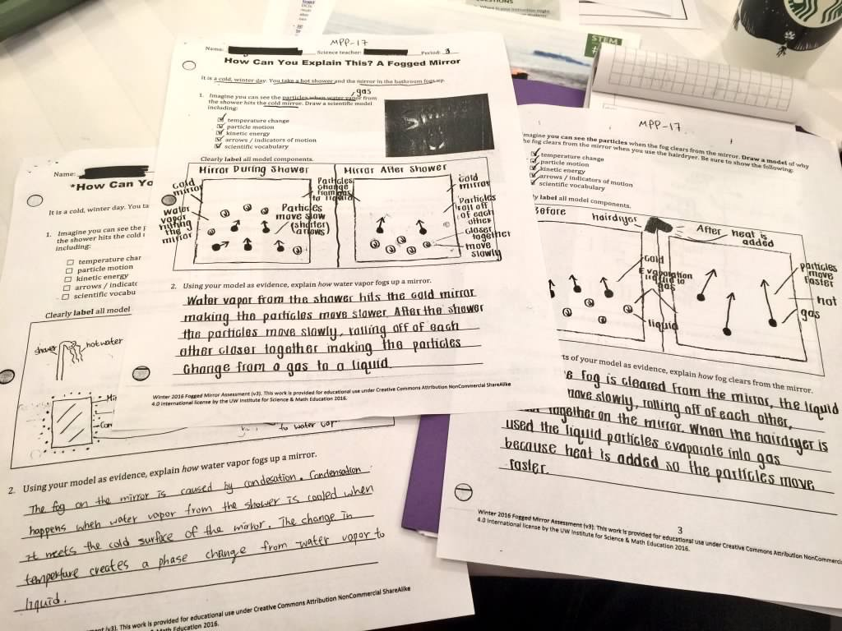
Sample Classroom Assessment
Notes:
This is a refined version of the same assessment after teachers improved it to better support Multilingual Learners in responding to the items by streamlining language and adding word banks to the modeling items. Here you see a few different student responses. We will be learning about and applying assessment design strategies for multilingual learners later in the session.
[estimated time: 30 sec]

Slide 10
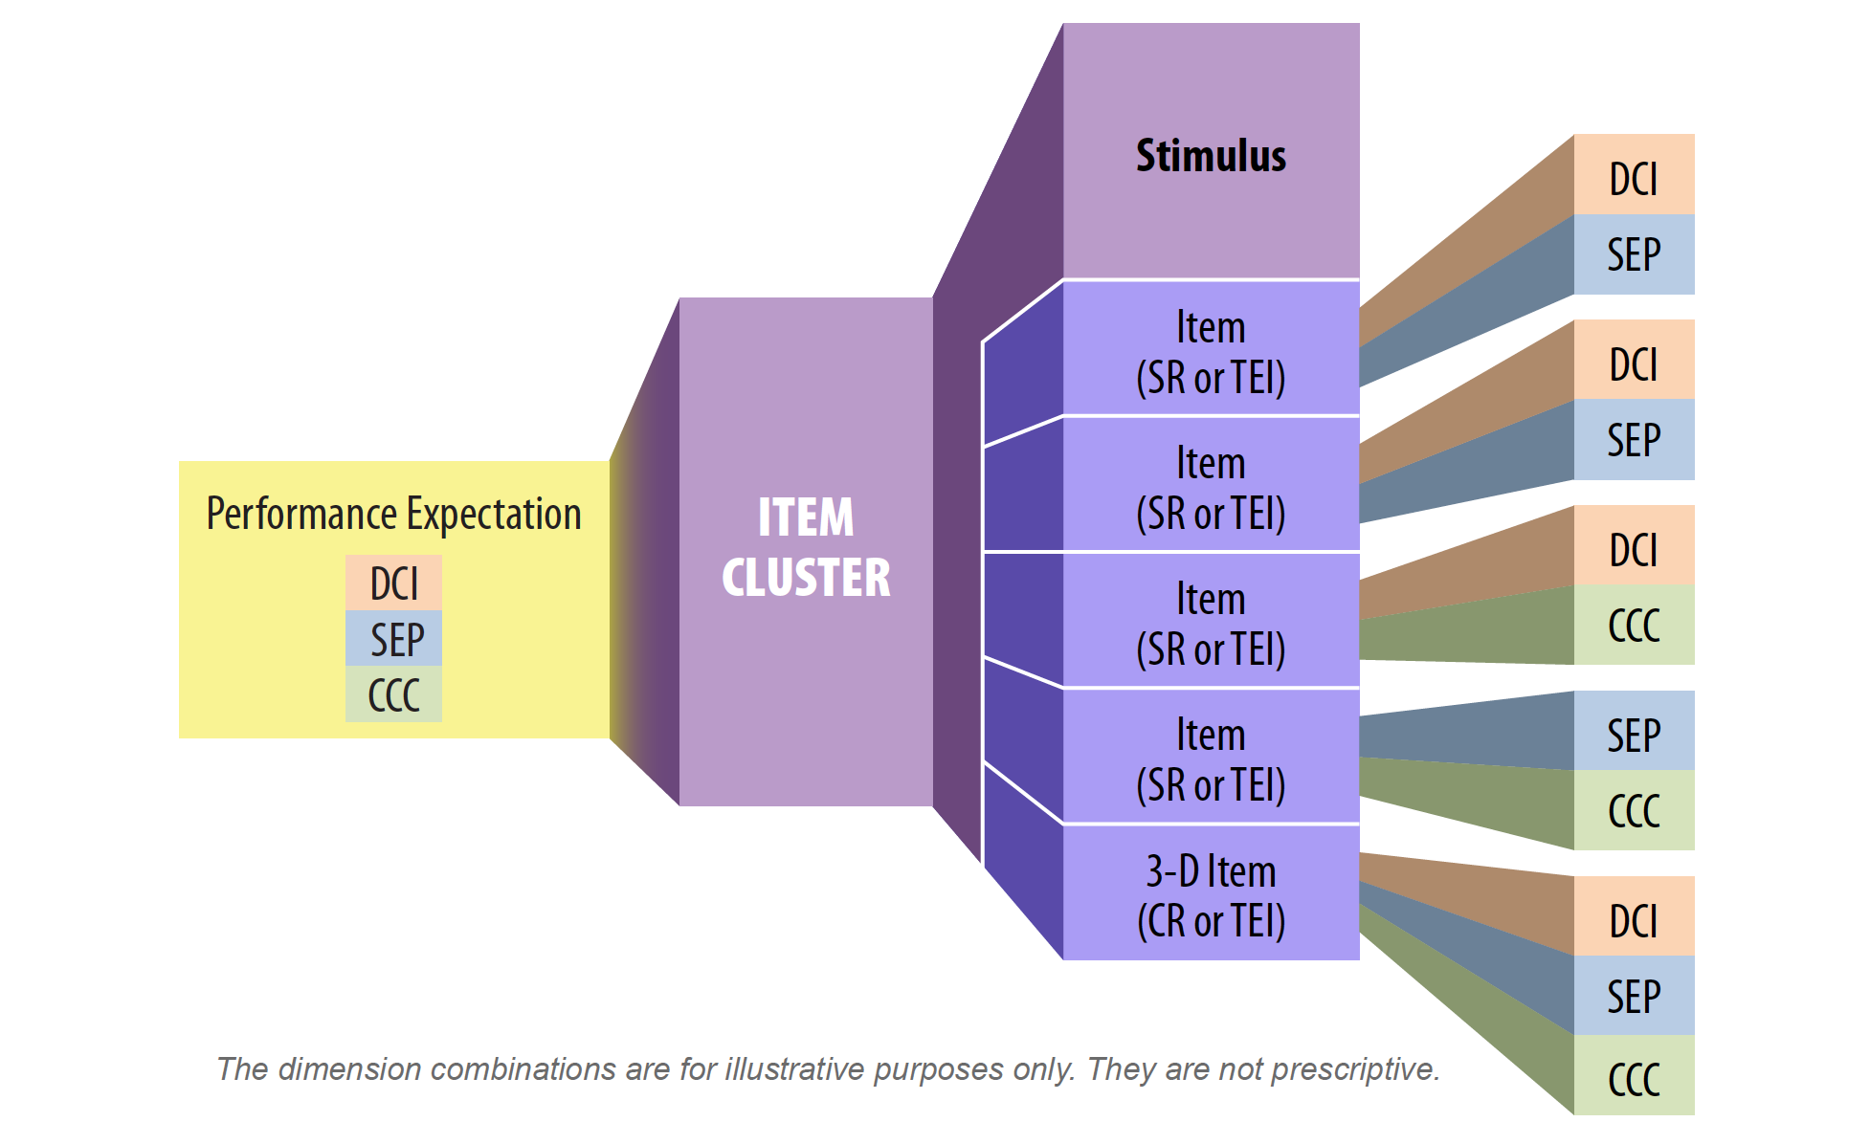
Designing Multi-Component Tasks
Focus on 3D learning performance (“claim”) related to a bundle of science, literacy & math standards
Notes:
How can we understand the multi-component design of this task? The approach we recommend builds on the work of a collaborative associated with the Council of Chief State School Officers’ that has been exploring how to design summative assessments of 3D learning that are “multi-component”.
((Reading the Diagram from right-to-left)) In this model, a cluster of items assess specific 2D and 3D learning goals as part of an item cluster for a given performance expectation. That was the sequence of related items—focused on engaging students in different science and engineering practices—as they expressed their conceptual understanding of science.
((Click Advance)) Since we are focused on designing formative assessments of different sizes, we are looking at assessing a specific 3D learning performance related to a bundle of science, literacy & math standards that corresponds to a major learning goal for a curriculum sequence. In the example, the assessment was gathering evidence on specific components of two science standards and one ELA standard.
((Click Advance)) We also focus on scenario-based approaches to assessment tasks (and not just general stimulus items in a broader sense). In the example, the scenario was about the “fogged mirror” phenomena that happened during a hot shower.
So, overall, we are focused on developing a coherent cluster of items that gauge 2D and 3D learning goals associated with a bundle of standards by asking students to make sense of phenomena highlighted in a scenario that is described.
((Stop and process the slide with the room.))
[estimated time: 3 min]

Slide 11
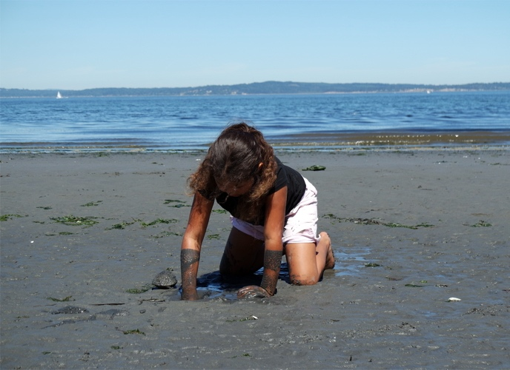
Equity & Diversity (NRC Framework Chapter 11)
Equalizing opportunities to learn
Inclusive science instruction
Science Learning as Cultural Accomplishment
Relating Youth Discourses to Scientific Discourses
Building on Prior Interest & Identity
Leveraging Students’ Cultural Funds of Knowledge
Making diversity visible
Value multiple modes of expression
Notes:
This is the table of contents of Chapter 11 in the NRC Framework. All of these dimensions are relevant to formative assessment.
[estimated time: 30 sec]

Slide 12
Equity & Diversity in Today’s Session (NRC Framework Chapter 11)
Equalizing opportunities to learn
Inclusive science instruction
Science Learning as Cultural Accomplishment
Relating Youth Discourses to Scientific Discourses
Building on Prior Interest & Identity
Leveraging Students’ Cultural Funds of Knowledge
Making diversity visible
Value multiple modes of expression
Notes:
These highlighted elements are the ones most directly related to today’s session. Formative assessment is a crucial strategy for equalizing opportunities to learn. Importantly, the Framework also highlights research-based ideas about inclusive science instruction that should be routinely used to engage learners in science learning. It also highlights the importance of valuing multiple modes of student expression (words, drawings, even gestures). In assessment, giving students multiple ways to express what they know helps make assessments fairer. We will see examples of all of these strategies today.
[estimated time: 30 sec]

Slide 13
Activity: Analysis of Assessment Tasks + Debrief
Notes:
How can we tell if science assessments are three dimensional? We will analyze a set of assessments to see if we can distinguish 3D assessments from other kinds of assessment tasks.
[estimated time: 15 sec]

Slide 14
Activity: Assessment Tasks Analysis
Notes:
((NOTE: These slides are designed to focus groups on a fifth-grade life sciences performance expectation. This PD module can be changed to focus on a range of different assessment items. See below if you want to change to a different one.))
Here’s a Performance Expectation for 5th grade Life Sciences…
((Read the PE and highlight the detail present in the foundation boxes across the three-dimensions.))
You will be looking to see if and how each assessment focuses on specific elements of each dimension of the performance expectation.
Hand out hard copies of 5-LS2-1 Sample Assessment Tasks…
http://stemteachingtools.org/assets/landscapes/Sample-Assessment-Tasks-for-Grade-5-LS2-1.pdf
[estimated time: 2 min]
((NOTE: This slide and the next one focus on a fifth-grade life sciences set, but facilitators can swap in other sets of assessments as they deem appropriate for their audience. The full set of options are here:
http://stemteachingtools.org/pd/sessionb
If you change to a different set of assessments, you will also have to update the Google docs that will be used in the session. More detail about this process is described in the facilitator’s guide for this session.))

Slide 15
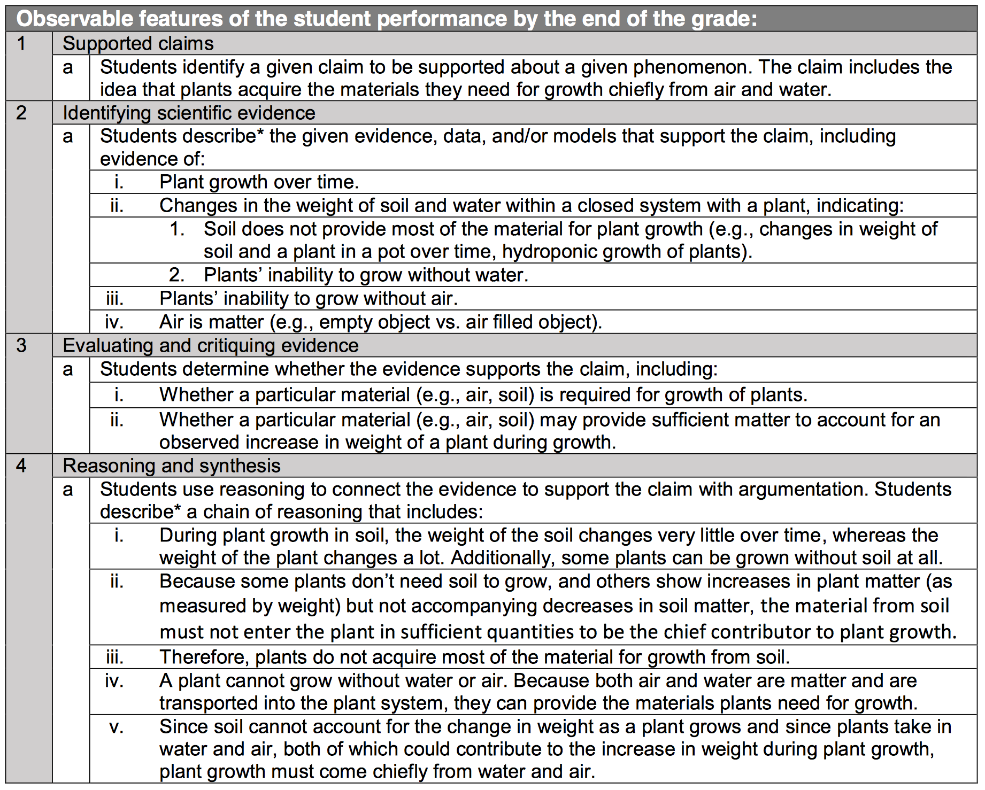
Image of NGSS Evidence Statement
Notes:
((NOTE: This is the NGSS Evidence Statement for the PE shown. It may not be relevant to your state context.))
This is the NGSS evidence statement for the PE shown. It highlights additional detail on what students should know and be able to do for each performance expectation. However, evidence statement were designed to guide summative assessments, so only specific elements would be appropriate for a given formative assessment.
[estimated time: 1 min]

Slide 16
Activity: Assessment Task Analysis
In breakout groups review and discuss the sample assessment tasks provided, all of which aim to assess the Performance Expectation.
A well-designed formative assessment will focus on a small number of pieces of a Disciplinary Core Idea, Science and Engineering Practice, or Cross-cutting Concept.
Try to identify those dimensions and see if they fit with the PE.
Rate each task in terms of how well you think it assesses the three dimensions integrated in the performance expectation (1 = not at all effective, 5 = highly effective)
Enter your ratings and explanations into this form.
INSERT-YOUR-TASK-ANALYSIS -LINK-HERE
Prepare to share your process, thoughts, and criteria you applied
for rankings with the whole group.
Notes:
Here’s the first activity…
((Read slide and engage the group in the activity))
((Note: To set up the poll, you will have to adapt it as described in the Facilitator’s Guide. Here’s the link to the template:
[estimated time: 8-13 min]

Slide 17
Whole Group Discussion: Assessment Task Analysis
How did our ratings compare? (review the data)
What are some criteria for deciding when a task is 3D?
Notes:
((Pull up the Google form results on the screen. Review the data together for each assessment item. Be sure to review the justifications with the group as you pose these questions))
Where was there agreement? Where was there disagreement? How did we decide if a task is 3D or not?
((It is likely that the group agreed about many of the items. Highlight this fact—to help people recognize they are perceiving “3D-ness.”. For the places where there is disagreement, ask about what caused the difference in analysis?))
What are some principles we could use, to decide whether an assessment is 3D or not?
((To the degree possible, surface the assessment design principle associated with people’s critiques. Write these down on butcher block paper for the group to refer back to.))
[estimated time: 4-6 min]

Slide 18
Steps to Designing 3D Assessments
Notes:
But how can we make assessments a better fit to the 3D vision for science learning for all students?
[estimated time: 15 sec]

Slide 19
Steps to Designing (Adapting) 3D Assessments
Step 1: Define what you will assess by analyzing relevant sections of A Framework for K-12 Science Education and NGSS and then crafting 3D learning performances (claims).
Step 2: Brainstorm Possible Scenarios for Eliciting Student Understanding.
Step 3: Write a Range of Student Questions using Task Formats for Practices and Prompts for Crosscutting Concepts to construct questions to engage students with the scenario.
Step 4: Imagine the Range of Possible Student Responses to the Questions.
Step 5: Share, Review, and Revise.
Notes:
This multi-step process can be used to design assessments from start to finish. It has been refined and is described in detail in STEM Teaching Tool #29:
http://stemteachingtools.org/brief/29
In order to “improve” the items we have been analyzing and make them more 3D, we will jump into Step 3 and use a couple of design tools to develop better questions.
[estimated time: 1 min]

Slide 20
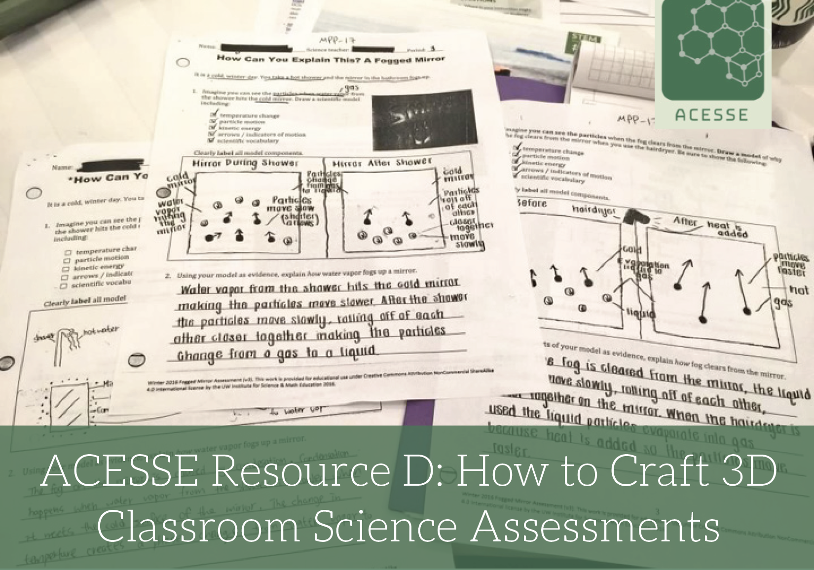
stemteachingtools.org/pd/SessionD

Slide 21
Tools to Support Assessment Item Development or Adaptation
Notes:
The STEM Teaching Tools site has a set of tools to support the development and adaptation of 3D assessments.
[estimated time: 15 sec]

Slide 22
Assessment Task Formats for the Practices
We created a collection of task formats for the science and engineering practices that help with the design of assessment components. They can also be used to guide instruction.
STEMteachingtools.org/brief/30
Notes:
The science and engineering practices are a central element of the 3D learning model—they are the foundation on which conceptual knowledge is developed and applied. They are the means by which students make sense of natural phenomena—or build solutions to problems—through sustained investigations.
((Read slide))
[estimated time: 30 sec]

Slide 23
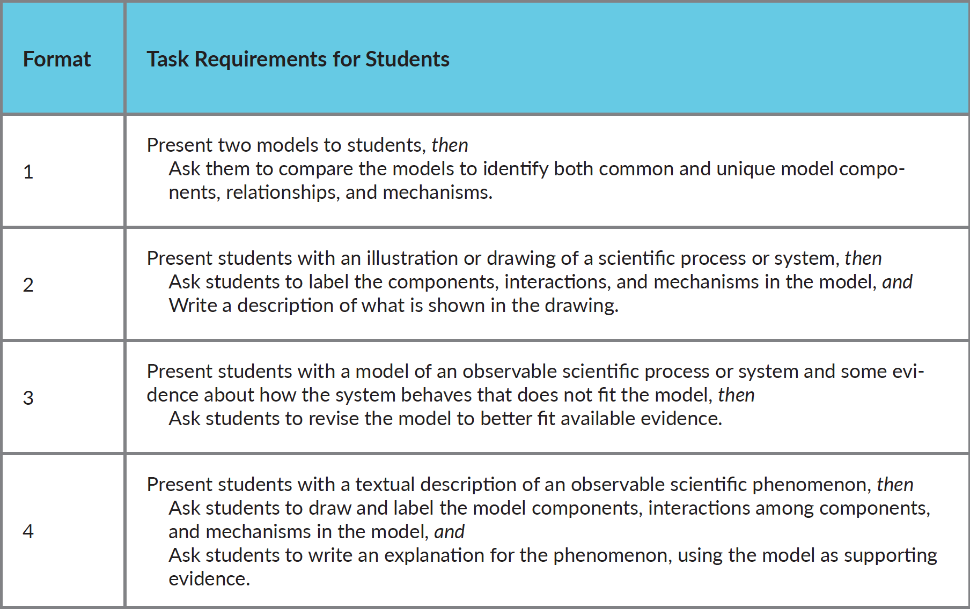
Task Formats for Developing & Using Models
stemteachingtools.org/assets/landscapes/STEM-Teaching-Tool-30-Task-Formats-for-3D-Assessment-Design-v2.pdf
Notes:
This tool offers between four and eight possible task formats for each of the science and engineering practices listed in the NRC Framework / NGSS. The task formats can give you specific ideas about how to craft assessment questions that engage students in the practice in question. The task formats are roughly ordered from less to more cognitively complex. Think of them as like blueprints for developing tasks that require students to engage in a practice to show what they know.
[estimated time: 15 sec]

Slide 24
Prompts for Assessing Cross-Cutting Concepts
STEMteachingtools.org/brief/41
Notes:
Similarly, cross-cutting concepts are another dimension of the 3D learning model. This STEM Teaching Tool helps you design questions about this dimension.
[estimated time: 15 sec]

Slide 25
Prompts for Assessing Cross-Cutting Concepts Example
STEMteachingtools.org/brief/41
Notes:
This tool highlights prompts that can be used in assessments or in classroom conversation to support the learning and application of these cross-cutting concepts that show up across the disciplines of science and engineering. These are some of the prompts for Cause and Effect.
[estimated time: 15 sec]

Slide 26
STEMteachingtools.org/brief/33
Notes:
It is particularly important to worry about how students who are not fluent English speakers are able to express their understanding of natural phenomena—on assessments and in conversation more generally. This tool highlights design principles for developing more inclusive assessments.
Read this tool and discuss it with an elbow partner or two, using the questions listed on the back. You should try to apply the design guidance on the back page as you improve an assessment.
(NOTE: The term emerging bilinguals is another way of referring to English Language Learners. Multilingual learners is an even newer term that is getting traction in our community.)
[estimated time: 5-7 min]

Slide 27
STEMteachingtools.org/brief/29
Notes:
We have developed detailed guidance and support tools for developing 3D assessment clusters. These resources are published on the STEM Teaching Tools site (http://stemteachingtools.org). This resource #29 maps out a detailed 10-step development process for 3D assessment clusters.
[estimated time: 2 minutes]

Slide 28
STEMteachingtools.org/brief/83
Notes:
Relatedly, STEM Teaching Tool #83 uses the same 10-step development process but focuses the 3D assessment clusters on justice-centered phenomena and topics related to science. This is a great resource to use to development assessments if you are wanting to focus on social justice.
[estimated time: 2 minutes]

Slide 29
Activity: Adapt an Existing Task + Debrief
Notes:
So let’s work to improve the assessments.
[estimated time: 15 sec]

Slide 30
Steps to Designing (Adapting) 3D Assessments (revisited)
Step 1: Define what you will assess by analyzing relevant sections of A Framework for K-12 Science Education and NGSS and then crafting 3D learning performances (claims).
Step 2: Brainstorm Possible Scenarios for Eliciting Student Understanding.
Step 3: Write a Range of Student Questions using Task Formats for Practices and Prompts for Crosscutting Concepts to construct questions to engage students with the scenario.
Step 4: Imagine the Range of Possible Student Responses to the Questions.
Step 5: Share, Review, and Revise.
Notes:
We are going to work on Step 3.
[estimated time: 15 sec]

Slide 31
Design (Adaptation) Work for Today
Step 3: Build Questions to Engage Students With the Scenario
Select one assessment to improve from the set.
Refine the assessment items to be more 3D and more fair (i.e., for ELL students).
Use the tools—one at a time—to guide your improvement work:
Task Formats for Science & Engineering Practices
Prompts for Crosscutting Concepts
Assessment Design Guidance for Emerging Bilinguals
Steps to Designing Justice-Focused Assessments
Steps to Designing Three Dimensional Assessments that Connect to Students’ Interests, Experiences, and
Identities
Enter you modifications here: INSERT-YOUR-TASK-REVISION-LINK-HERE
Notes:
In groups of 2 or 3, select an assessment item to improve and use the task formats to make the cluster more three dimensional. Here are links to the assessment tasks:
Grade 1 PS4-3: The Path of a Beam of Light
Grade 4 PS4-1: Wave Amplitude, Wavelength, and Effects
Grade 4 ESS2-1: The Effect of Weathering on the Rate of Erosion by Water, Ice, Wind, or Vegetation
Grade 5 LS2-1: The Movement of Matter Among Plants, Animals, Decomposers, and the Environment
MS-PS4-2: Waves and Their Applications in Technologies for Information Transfer
MS-LS-4-4: Genetic Variation and Probability of Survival in a Specific Environment
MS-ESS2-6: Patterns of atmospheric and oceanic circulation
HS-LS-2-1: Factors that Affect Ecosystem Carrying Capacity
Intentionally use the three tools we just learned about to support your work. Now let’s get to work.
((Note: To set up the poll, you will have to adapt it as described in the Facilitator’s Guide. Here’s the link to the template:
http://tinyurl.com/AcesseResourceBTaskTemplate ))
[estimated time: 8-13 min]

Slide 32
Whole Group Discussion: Assessment Task Adaptation
What did you come up with?
You likely focused improvements on the practice(s) outlined in the PE. Did you add any additional items for other practices as well? Any engineering practices?
Did you embed prompts to surface reasoning about crosscutting concepts?
How might you use this process for designing or adapting tasks in your school or district?
Notes:
((Read and process the slide))
[estimated time: 4-6 min]

Slide 33
Criteria for Assessment Scenarios
It should allow students from non-dominant communities (e.g., multilingual learners, students from poverty-impacted communities) to fully engage with the task. We should design for them first!
It should involve a compelling phenomena related to one or more of the DCIs being assessed—and not feel like a test-like task. It should beg for explanation! Make it more like an anchoring phenomena for an awesome, month-long unit.
It should lend itself to a broad range of the science and engineering practices.
It must be understandable quickly by students.
For this reason, selecting everyday situations can be useful.
Notes:
We didn’t focus on this today, but assessment scenarios themselves can be a major source of inequity.
In the Introduction to Formative Assessment PD Session, we described these criteria for the selection of assessment scenarios. Assessment scenarios need to be quickly understandable by as many students as possible. Often specific scenarios from everyday life are culturally unfamiliar to some students.
((Ask the room to skim the criteria))
It is ideal to test out assessment scenarios with your actual students. As you think about the one you worked on today, you might want to refine or adjust it to make it more fair.
[estimated time: 2 min]

Slide 34
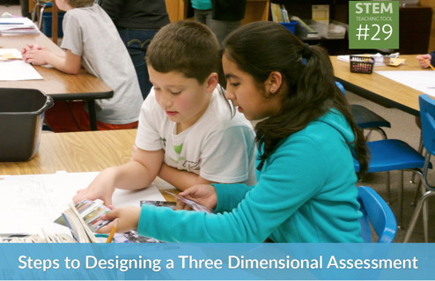
Steps to Designing 3D Assessments: Short Course
tinyurl.com/3Dassessmentdevelopment
Notes:
As part of an effort called the Research + Practice Collaboratory funded by the National Science Foundation, a team of researchers and educators have started developing professional learning resources for the development of 3D cognitive assessments and interest- and identity-focused cultural assessments. This is the online, short course mentioned earlier that provides an overview of those resources.
[estimated time: 30 sec]

Slide 35
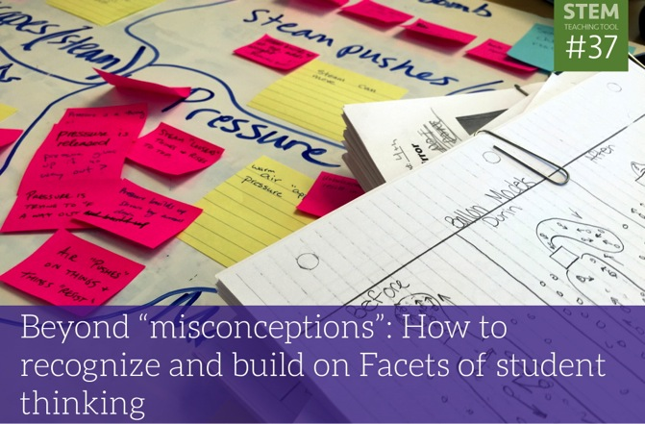
Theme: Briefs on Formative Assessment
stemteachingtools.org/tgs/Assessment
Notes:
The STEM Teaching Tools site includes a wide range of professional learning resources on 3D assessment, including some of those we used today.
[estimated time: 15 sec]

Slide 36
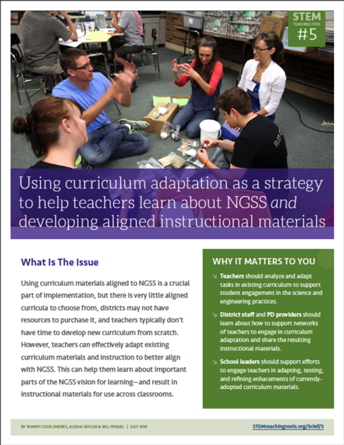
Professional Learning Resources to Support NGSS Implementation
Co-designed by practitioners & researchers
Tested & refined over time
Easily shareable—over social media, email, paper
STEMteachingtools.org (web)
@STEMteachtools (twitter)
pinterest.com/stemeducation (pinterest)
Notes:
These tools are all part of a broader collection of resources designed to support implementation of the NRC Framework and NGSS vision.
[estimated time: 15 sec]

Slide 37
Help us improve the resource Please take the following 5 minute survey to help the ACESSE team improve this resource for others. http://tinyurl.com/AcesseResourceB
Notes:
((Read and ask participants to complete the survey. Clarify that this is information for the ACESSE team to refine the—and not for you as the facilitator.))
[estimated time: 3-5 min]

Slide 38
Thank you! For more info…
Related Resources
Formative Assessment Short Course tinyurl.com/NGSS-3D-assessment-course
STEM Teaching Tools STEMteachingtools.org @STEMTeachTools (twitter)
Next Generation Science Assessment ngss-assessment.portal.concord.org
Contact Us
ACSSE Project STEMteachingtools@uw.edu @ACESSEproject
Shelley Stromholt stromhos@uw.edu @sshellery
Philip Bell pbell@uw.edu @philiplbell
Katie Van Horne katie.vanhorne@colorado.edu @dizzvh
William Penuel william.penuel@colorado.edu @bpenuel
Tiffany Neill tiffany.neill@sde.ok.gov @tiffanyneill
Sam Shaw Sam.Shaw@state.sd.us @SciencEDU
This resource was developed through the ACESSE project funded by the National Science Foundation (NSF) through Award DRL-1561300 and the Research + Practice Collaboratory funded by NSF through DRL-1626365. The opinions do not represent those of the funder.
Notes:
Here are some resources and contact information for the authors of this PD unit. They hope you have found it useful. They welcome any feedback or suggestions on how to improve it. This resource developed with funding from the National Science Foundation.
[estimated time: 30 sec]

