Slide 1
How to Craft 3D Classroom Science Assessments
Philip Bell
Deb Morrison
University of Washington
With contributions from Lizette Burks, Ellen Ebert, Michael Heinz, Kris Kilibarda, Cathy Mackey, Tiffany Neill, Bill Penuel, Robbin Riedy, Jamie Rumage, Megan Schrauben, Sam Shaw, and Katie Van Horne
November 2017, Updated Feb. 2020
This work is licensed under a Creative Commons Attribution-ShareAlike 4.0 Unported License. Educators and others may use or adapt. If modified, please attribute and re-title. CC BY-SA license details are at https://creativecommons.org/licenses/by-sa/4.0/
Notes:
In this workshop, we will consider how to craft 3D learning performances and related formative assessments that connect to learners’ interest and knowledge while at the same time promote equity and social justice. The material for this resource comes from a series of PD sessions on formative assessment developed by Philip Bell and Deb Morrison.
[estimated time: 1 min]
((There is a Facilitator’s Guide available for this resource: http://tinyurl.com/ACESSE-ResourceD-Guide ))
((This resource was refined through a 13-state collaboration to make the resource more broadly useful. If you choose to adapt these materials, please attribute the source and that it was work funded by the National Science Foundation (NSF).))

Slide 2
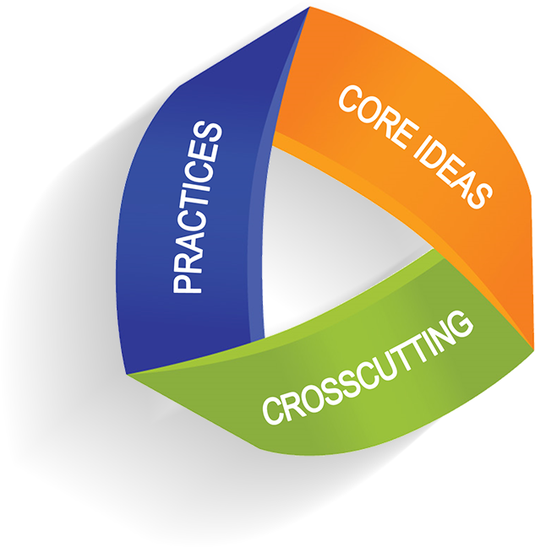
3D Formative Assessment
Notes:
All three learning dimensions described in the NRC Framework for K-12 Science Education need to be taken into account for horizontal coherence — across curriculum, instruction, assessment, and professional development.
[estimated time: 1 minute]

Slide 3
Formative Assessment
“A process used by teachers and students during instruction that provides feedback to adjust ongoing teaching and learning to improve students’ achievements of intended instructional outcomes.”
— Formative Assessment for Students and Teachers (FAST) SCASS, 2012, p. 4
Goes beyond educational standards. Includes all instructional outcomes.
Notes:
This is the definition for formative assessment we will use today to guide our work. This comes from an effort initiated by CCSSO (Council of Chief State Science Officers).
[estimated time: 1 min]

Slide 4
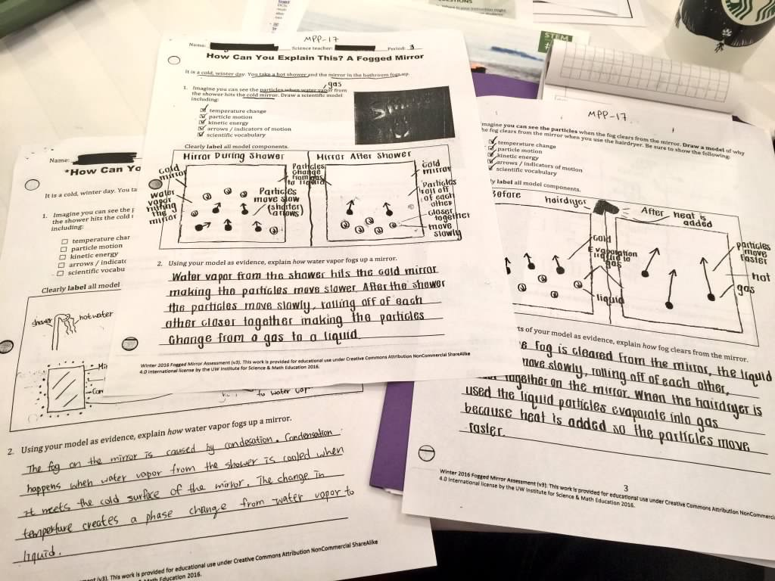
Image of student work on a table
Notes:
Instruction should include a sequence of different kinds of formative and summative assessments. There are cognitive assessments focused on gauging student’s conceptual understanding—and cultural formative assessments focused on guiding instruction based on student’s interests, experiences, and goals.
Cognitive formative assessments are likely somewhat similar what you’re used to seeing or developing. This is a picture of student responses to an assessment from the Partnership for Science and Engineering Practices, a project of UW’s Institute for Science and Math Education with Seattle Public Schools and Renton School District. Today’s session is focused on supporting teachers in designing 3D cognitive formative assessments.
[estimated time: 1 minute]

Slide 5
3D Assessment Tasks
Should have multiple components that include connected use of different science and engineering practices focused on application of interconnected disciplinary ideas and crosscutting concepts;
Address progressive nature of learning by providing info about where students fall on a continuum between expected beginning and ending points in a given unit or grade; and
Include an interpretive system for evaluating range of student products that are specific enough to be useful for helping teachers understand the range of student responses and provide tools for helping teachers decide on next steps in instruction.
Notes:
((READ SLIDE))
[estimated time: 2 min]

Slide 6
The Formative Assessment Process (from Beth Simpson & Amber McCulloch)
Clarify
Intended
Learning
Evidence
Elicit
Act on
Evidence
Interpret
Evidence
Notes:
The Formative Assessment process can be understood as involving four steps. ACESSE Resource A deeply describes this process with a worked example.
Today we are focused on designing a written cognitive assessment that elicts evidence of how students understand the learning goals associated with 3D performance expectations. We will have to also spend some time clarifying the intended learning goals that are the focus of the assessment task we will craft.
Recall: With cognitive formative assessment, we are focused on surfacing the learning resources that students bring to an instructional moment. In ACESSE Resource E, we highlight how “facets of student understanding” can be identified—and used to guide instruction. We should not be looking for how students might be wrong (i.e., identifying misconceptions). We are trying to recognize the range of ideas students bring to sense-making so we can help them refine them.
From a cognitive formative assessment perspective, ACESSE Resource E focuses on the bottom of the clover leaf—how to interpret the range of student thinking and act on it in instruction.
From a cultural formative assessment perspective, ACESSE Resource C shows how to focus instruction on the interests, knowledge, and identities of students and their communities. That half-day session goes through the full clover leaf process. This is a strategy for supporting culturally relevant and sustaining instruction.
[estimated time: 2 min]

Slide 7
Overview of the Session Goals
Learn about 3D Learning Performances as lesson-level learning goals related to unit-level bundles of 3D performance expectations.
Craft a 3D classroom assessment focused on a specific 3D learning performance for formative use.
Engage in peer review to study and refine “3dness” of our drafted assessments.
Notes:
There are three goals for this session… ((READ SLIDE))
One thing to note explicitly is that this session is not about a product so much as it is about capacity building around the process of creating a product (eg. 3d formative assessment). So encourage reflection and questioning throughout activity.
[estimated time: 1 minute]

Slide 8
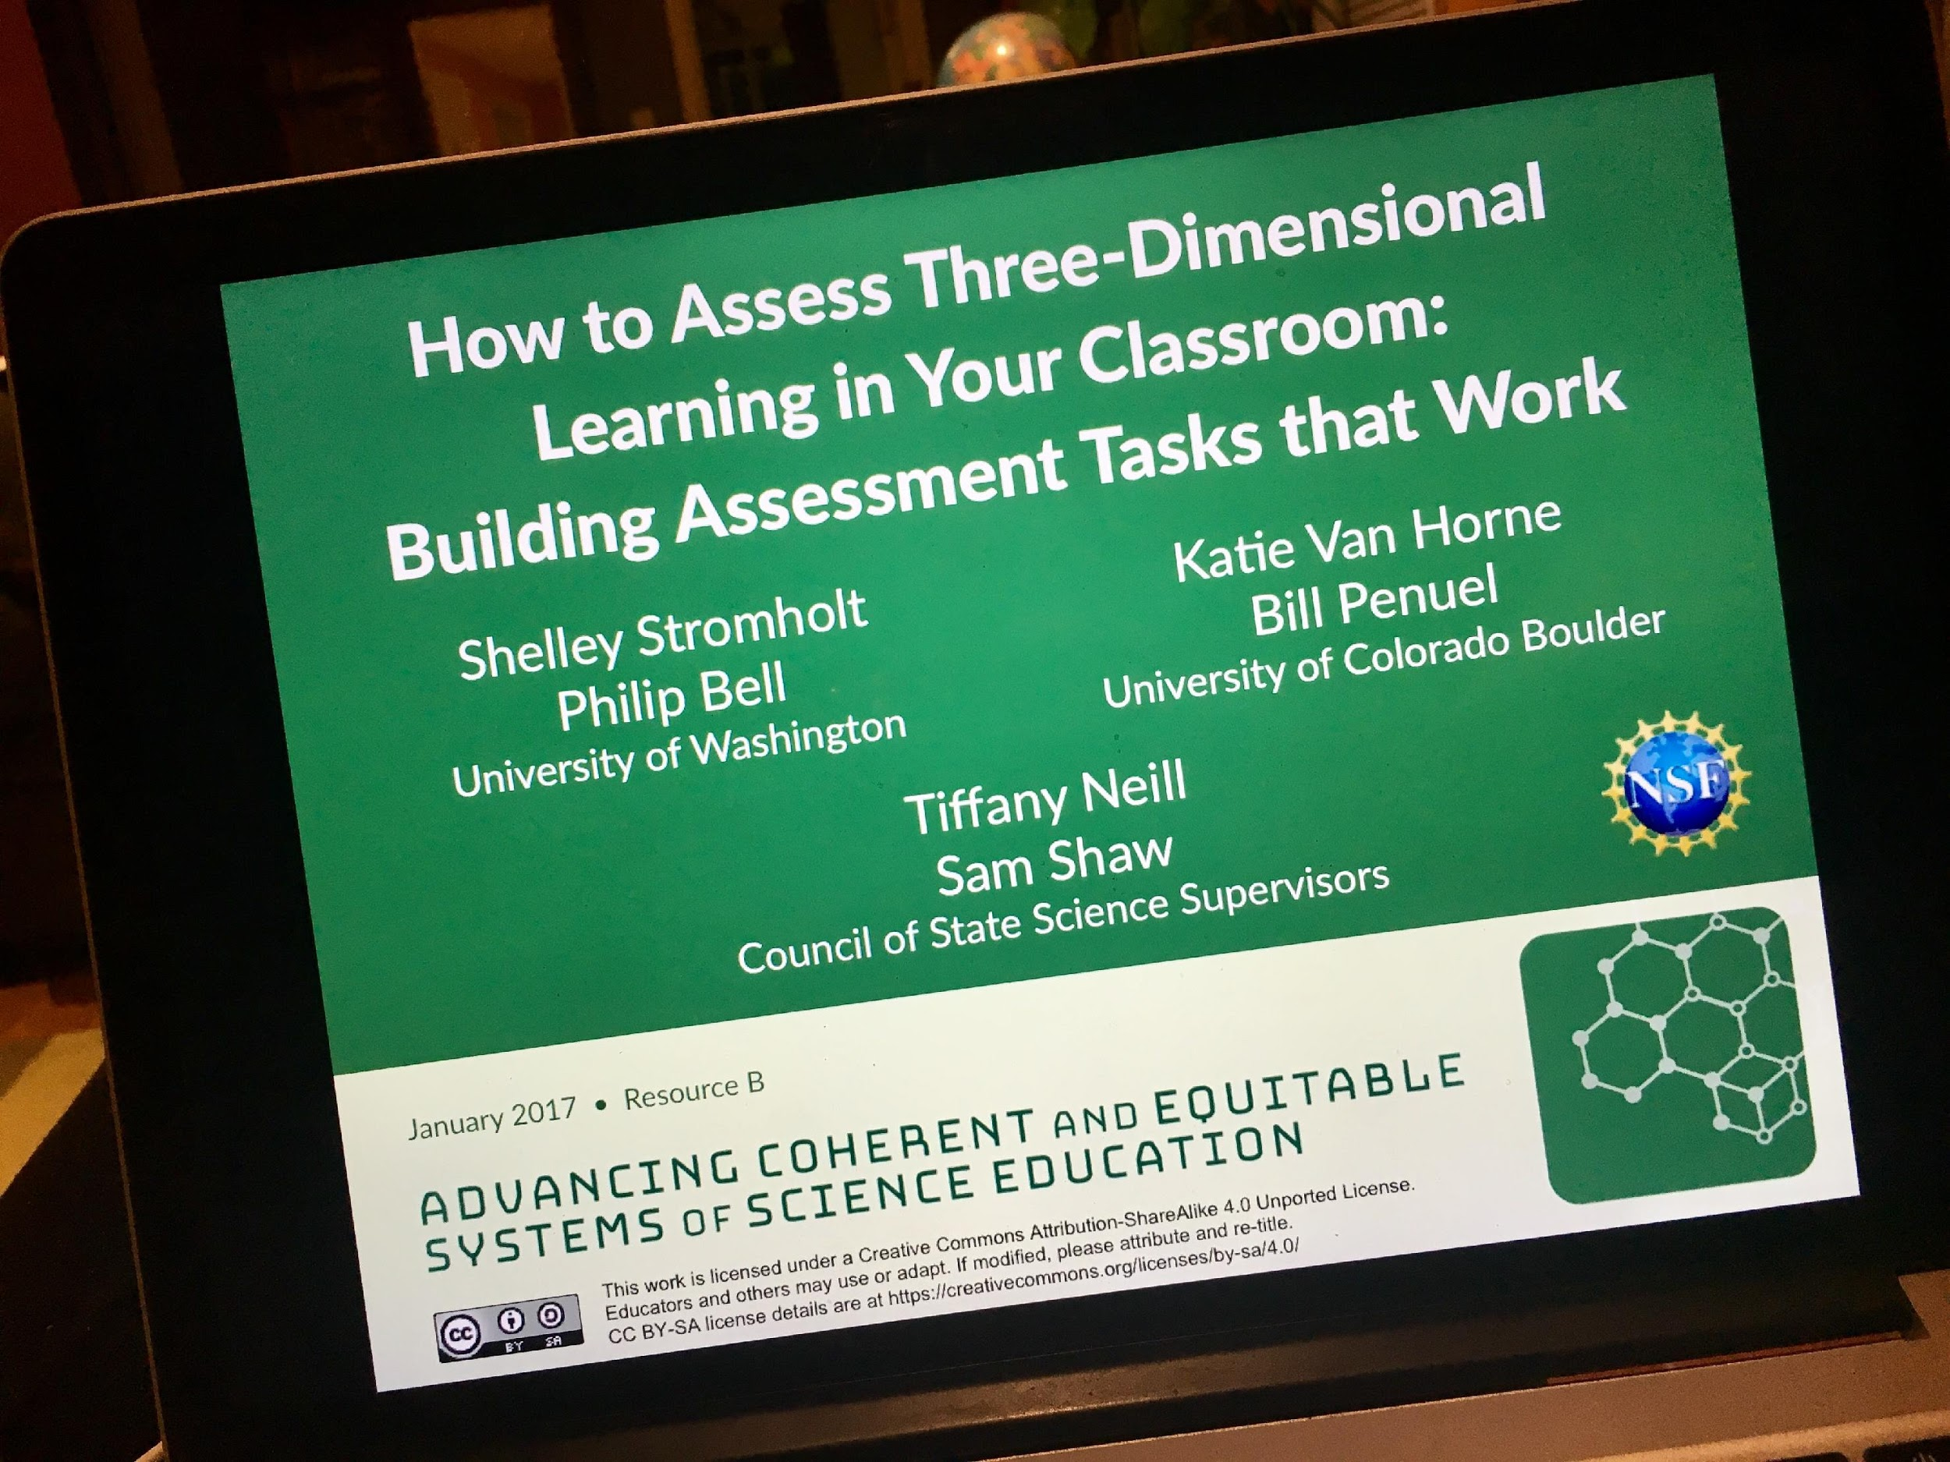
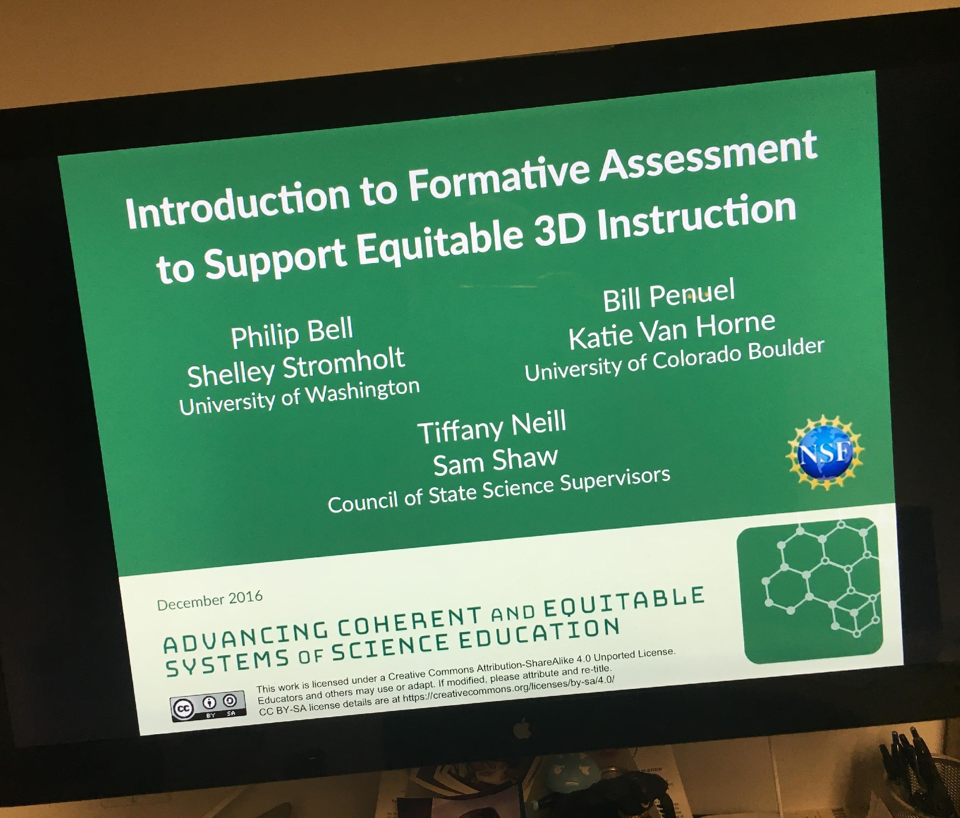
ACESSE Open Ed Resources on Formative Assessment for Science Ed
Intro PD Module
PD Module on “3Dness”
stemteachingtools.org/pd/SessionA
stemteachingtools.org/pd/SessionB
Elements: slide deck, speaker notes, (brief) facilitator guide, resources. Published on: STEMTeachingTools.org
Notes:
Today’s session builds on ideas, tools, and strategies developed in previous professional learning sessions. The ACESSE project resources are available on the STEMteachingtools.org site under the “pd module” tab. The site includes a range of tools related to formative assessment, including these two.
[estimated time: 1 minute]

Slide 9
Approaching Learning and Teaching from a 3D Perspective
Notes:
Now let’s do some thinking about designing 3D cognitive formative assessments for the classroom.
[estimated time: 15 seconds]

Slide 10
Develop a personal 3D learning performance…
Select one of your favorite hobbies & think of a big learning goal that matters — a performance expectation — PE: Double-spin juggling of three pins using both hands
1. Unpack an important piece of core knowledge that is needed to do that — How “hard” to flip a juggling pin to get 2 rotations for a given arc
2. Unpack a practice that demonstrates that they know that piece of knowledge? (knowledge-in-use) — Repeated, single-hand double flipping of a juggling pin
3. Unpack a cross-cutting concept learned as well — Hand-eye coordination that relies on peripheral vision & timing
My 3D Learning Performance: “The learner is able to double flip a pin over-and-over in one hand while looking away.”
double flip = piece of core knowledge
a pin over-and-over in one hand = practice
looking away = cross-cutting concept
Notes:
Before eliciting evidence of student thinking it is important to clarify intended learning. At the scale of lesson planning, this process is sometimes called establishing specific learning goals or learning. These will help us identify 3D assessment claims (see STEM Teaching Tool #29 for background). To make firm connections to the Framework we use the term 3D learning performances.
We’ll think about lesson-level 3D learning performances by first thinking about a personal area of learning….((TALK THROUGH the slide, build it out))
We are going to create our 3D learning performance during the construction of our 3D assessment task; however, some of you may have already clearly laid out 3D learning performances across your unit of instruction.
[estimated time: 3 minutes]
((NOTE: You can customize the slide to be about a domain that you are an expert in by swapping out the blue text and the final 3D Learning Performance. Elementary school teachers seem to appreciate talking about a non-science example, but secondary teachers prefer to discuss a science example.))

Slide 11
Unit Assessment Sequences
Diagnostic
Pre-Test
Formative (e.g., Daily Assessment)
Formative
(e.g., Small Group Conversations)
Formative (e.g., Presentation)
Formative
(e.g., Classroom Conversation)
Summative
End-of-Unit
(graded)
Background Resource: Seeing Student Learn Science
Notes:
A sequence of formative assessment events should be embedded throughout a unit in order to guide student sense-making and learning in response to their progress on the intended learning goals. You may want to start the unit with a pre-assessment that you use to gauge where students are starting. The formative assessments take many different forms. Today we are focused on designing a 3D daily assessment.
It is useful to think of “formative assessment” as a verb (an action)—and not a noun (a thing). To guide instruction, we do formative assessment—not give them.
[estimated time: 2 minutes]

Slide 12
3D Learning Performance Sequences
Break down unit 3D learning goals (from a bundle of PEs) into more lesson-level 3D learning performances (LPs)
LP
LP
PEs
LP
…
Formative Assessments
Summative Assessment
PEs = 3D Performance Expectations
LP = Learning Performance (at lesson level)
Background: nextgenscienceassessment.org
Notes:
Today we will be developing 3D Learning Performances—that link together across a unit to represent the learning described within a performance expectation.
These connections also parallel instructional activities in lessons that collectively form the unit as well as sequences of formative assessments that allow educators to check for understanding and adjust instruction before unit summative assessments.
Thus at each stage within a unit there is a 3D learning performance followed by some kind of learning activity and assessed through a 3D formative assessment. Collectively these practices form the unit and reflect the complex 3D learning goals set out in the selected performance expectations.
[estimated time: 2-3 minutes]

Slide 13
Discussion
How do / might you use sequences of embedded formative assessments—of different kinds—in your teaching of a unit?
Notes:
((READ SLIDE))

Slide 14
STEMteachingtools.org/brief/29
Notes:
In terms of building 3D assessments, STT 29 is a helpful resources, however our process for today has expanded this work into a bit more detail for use at a fine grained scale of lesson planning. At this scale we are trying to ensure that the instruction in the classroom is deeply connected to the assessment event and vice versa.
[estimated time: 1 minute]

Slide 15
Image of student work on a table
Notes:
((Hand out a copy of the fogged mirror assessment.))
Let’s explore a sample assessment. This is a sample student response for the Fogged Mirror MS classroom assessment example we discussed earlier. Please take note of some specific features that are called out: (a) the scenario description, (b) learner scaffolds, (c) a sequence of 2D and 3D items, which includes (d) spaces for student’s multi-modal expression (diagram, text).
This is the kind of assessment we will be developing today.
[estimated time: 5 min]

Slide 16
3D Assessment Task Design Process
Product: daily classroom assessment (5-20 min task)
STEP 0: Become familiar with qualities of three-dimensional assessment tasks
STEP 1. Define what you will assess by analyzing relevant sections of A Framework for K-12 Science Education and crafting learning claims
STEP 2: Analyze the facets of the claim to be assessed
STEP 3: Choose a phenomenon or a design challenge for the task
STEP 4: Write a complete student explanation of the phenomenon or solution to the design challenge
Notes:
((Hand out the accompanying “Crafting a 3D Classroom Assessment” worksheet now.))
This is the 7 step process we will follow to design a 3D formative assessment at the lesson scale of activity. It will be something you can use in the classroom immediately. We are going to step through each of these steps as we design a 3D formative assessment task for a particular lesson situated within a unit of study. You should focus on learning how to design assessments that you have time to develop in your practice. Perhaps stay focused on small aspects of the performance expectations—at least to start with.
Take a minute and look over the process and the worksheet we will be using to capture our work.
Organize into groups around particular curriculum units / lessons or content domains.
Name your group focus at top of worksheet under “lesson name” to connect your assessment work to a particular lesson sequence inside of a unit.
[estimated time: 2-3 minutes]

Slide 17
3D Assessment Task Design Process
Assessment Development Process (continued):
STEP 5: Use the Science and Engineering Practices and Crosscutting Concepts Tools to develop individual prompts
STEP 6: Integrate questions to assess student interest and identification with science and engineering presented in the scenario
STEP 7: Develop ideal student answers and a scoring guide
STEP 8: Review your task with peers for intelligibility, alignment, and accessibility
STEP 9: Pilot and revise your assessment
Notes:
((Hand out the accompanying “Crafting a 3D Classroom Assessment” worksheet now.))
This is the 7 step process we will follow to design a 3D formative assessment at the lesson scale of activity. It will be something you can use in the classroom immediately. We are going to step through each of these steps as we design a 3D formative assessment task for a particular lesson situated within a unit of study. You should focus on learning how to design assessments that you have time to develop in your practice. Perhaps stay focused on small aspects of the performance expectations—at least to start with.
Take a minute and look over the process and the worksheet we will be using to capture our work.
Organize into groups around particular curriculum units / lessons or content domains.
Name your group focus at top of worksheet under “lesson name” to connect your assessment work to a particular lesson sequence inside of a unit.
[estimated time: 2-3 minutes]

Slide 18
STEP 0: Become familiar with qualities of 3D assessment tasks
Read the STEP 0 description on STT#29 PDF and engage in the work there. The link referenced to the Swallows assessment task is: https://achieve.org/evolution-swallows Discuss the Criteria for 3D Assessment Tasks from the Achieve Science Task PreScreen tool.
Notes:
((Read slide))
We want to focus on designing an assessment you can use immediately and one that “gets after” a small piece of the standard.
((Use next two slides if you want to provide an example—and then come back to this slide. Ask people to use their worksheet to track their work.))
[estimated time: 5-10 minutes with work time]

Slide 19
Learning Performance = Learning Claim
Notes:
((READ SLIDE))
[estimated time: 5 minutes]

Slide 20
Step 1. Define what you will assess by analyzing relevant sections of A Framework for K-12 Science Education and crafting learning claims
Think about your instructional unit. Pick a learning claim (performance) that is challenging for students to learn— yet crucial for them to understand.
Notes:
((Read slide))
We want to focus on designing an assessment you can use immediately and one that “gets after” a small piece of the standard.
((Use next two slides if you want to provide an example—and then come back to this slide. Ask people to use their worksheet to track their work.))
[estimated time: 5-10 minutes with work time]

Slide 21
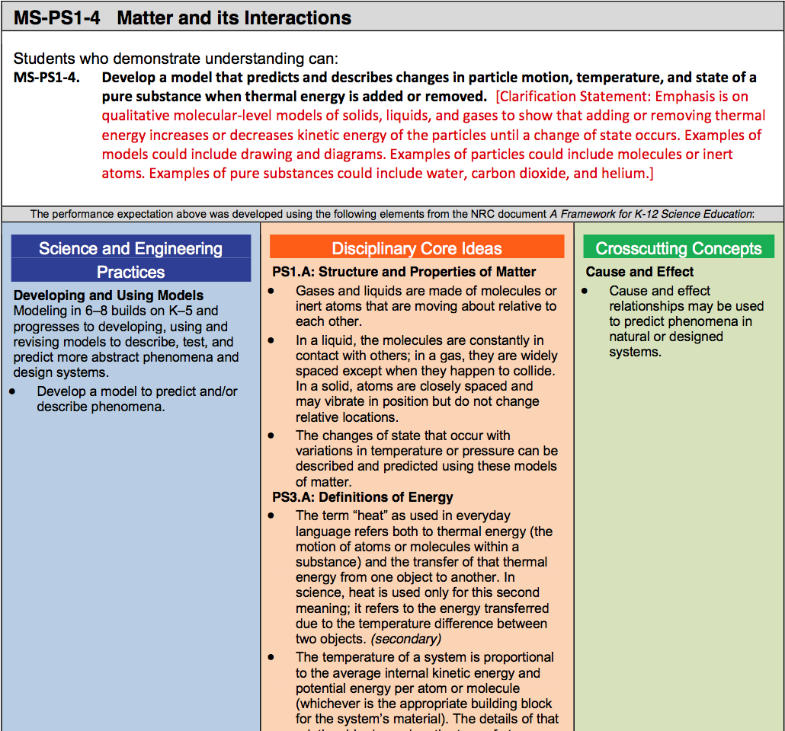
It can be part of a PE—or a learning performance that leads up to a PE.
Notes:
((This example goes with the fogged mirror assessment.))
Here’s a middle school Performance Expectation for Physical Science…
((Read the PE and highlight the detail present in the foundation boxes across the three-dimensions. Identify a specific DCI component.))
You will be looking to see if and how each assessment focuses on specific elements of each dimension of the performance expectation.
[estimated time: 2 min]

Slide 22
Don’t forget to consult the Framework…
Notes:
((This example goes with the fogged mirror assessment.))
Here’s a middle school Performance Expectation for Physical Science…
((Read the PE and highlight the detail present in the foundation boxes across the three-dimensions. Identify a specific DCI component.))
You will be looking to see if and how each assessment focuses on specific elements of each dimension of the performance expectation.
[estimated time: 2 min]

Slide 23
Sample 3D Learning Performances
Weather Unit: Students analyze climate data to determine the effects of latitude on average temperature.
DCI: Weather Model Kit 1-3 Practice: Analyze & Interpret Data Task 3 CCC: Patterns
Light Unit: Students compare two models for how light from light sources makes objects visible to an observer and use evidence to support a claim about which they think is correct.
DCI: Light Model Kit 1-3, 5 Practice: Modeling Task 1 & Argumentation Task 3 CCC: Structure & Function
Genetics Unit: Students construct a model to predict the relationship between the genotype and phenotype of an organism.
DCI: Genetics Model Kit 4-8 Practice: Model Task 2 CCC: Structure & Function
Notes:
Here are some middle school examples of 3D learning performances and their associated DCI, SEP and CCC. In this curriculum adaptation project, teachers and district staff defined a set of rules that defined an instructional conceptual model (the “model kit”) related to components of the DCIs in the unit bundle. So they have listed those “model kit” pieces here as a shorthand for the DCI components. See how they make direct use of the Science and Engineering Practice task formats.
[estimated time: 2 min]

Slide 24
3D Learning Performance Mad Lib
“Students ((science & engineering practice component verb clause)) in order to ((DCI element verb clause)) highlighting that ((cross-cutting concept clause)).”
—Julia Ward, Seattle Public Schools
Notes:
So, how should we go about crafting a 3D Learning Performance for our focal lesson? Here is a “mad lib” strategy from a middle school teacher in Seattle for constructing your 3D Learning Performance—or claim of what students should be able to do.
Go ahead and write a 3D Learning Performance draft for the formative assessment you are developing today. Try to attend to all three component dimensions.
[estimated time: 5-10 minutes]

Slide 25
STEP 1. Define what you will assess by analyzing relevant sections of A Framework for K-12 Science Education and crafting learning claims
Read the STEP 1 description on STT#29. Develop and list your learning claim in your group’s workspace
Notes:
((Read slide))
We want to focus on designing an assessment you can use immediately and one that “gets after” a small piece of the standard.
((Use next two slides if you want to provide an example—and then come back to this slide. Ask people to use their worksheet to track their work.))
[estimated time: 5-10 minutes with work time]

Slide 26
STEP 2: Analyze the facets of the claim to be assessed
A learning claim may have many facets. A facet is a small observable piece of knowledge or a strategy that a student uses to make sense of a problem (Minstrell, 1992).
Notes:
((Read slide))
We want to focus on designing an assessment you can use immediately and one that “gets after” a small piece of the standard.
((Use next two slides if you want to provide an example—and then come back to this slide. Ask people to use their worksheet to track their work.))
[estimated time: 5-10 minutes with work time]

Slide 27
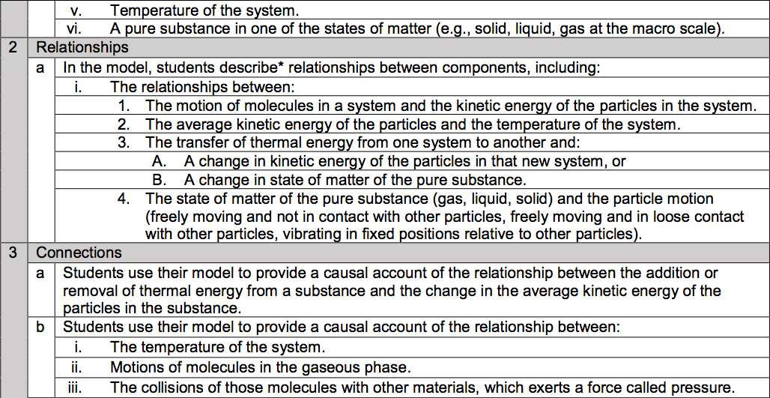
Image of NGSS evidence statement
Notes:
((Use this as example as desired))
This is the NGSS evidence statement for the middle school PE we just looked at. It highlights additional detail on what students should know and be able to do for each performance expectation. Evidence statement were designed to guide summative assessments, so only specific elements would be appropriate for a given formative assessment—as students make progress on learning the overall set of components.
For our purposes, we will identify a specific component of a DCI, For example, with this PE the idea that “thermal energy can be transferred from one system to another and change the state of matter of a pure substance” (2.a.3.B) is an important idea for students to come to understand.
((NOTE: This is the NGSS Evidence Statement for the PE shown. It may not be relevant to your state context.))
((GO BACK two slides and let individuals / groups work on identifying a DCI component.))
[estimated time: 1 min]

Slide 28
STEP 2: Analyze the facets of the claim to be assessed
Read the STEP 2 description on STT#29 and follow the instructions—which includes creating a set of stickies for each facet you identify for your claim.
Notes:
((Read slide))
We want to focus on designing an assessment you can use immediately and one that “gets after” a small piece of the standard.
((Use next two slides if you want to provide an example—and then come back to this slide. Ask people to use their worksheet to track their work.))
[estimated time: 5-10 minutes with work time]

Slide 29
STEP 3: Choose a phenomenon or a design challenge for the task
We want to identify a phenomena-driven scenario that relates to our learning performance. It will frame the assessment event for students. There are different kinds of scenarios: (a) everyday situations, (b) science investigations, (c) classroom situations, or (d) hypothetical situations.
Notes:
Assessment scenarios are what assessment developers call “the stimulus.” They become the context that students reason about.
((READ SLIDE))
Here’s some Background on the Different Kinds of Scenarios:
Everyday Situation: invokes a common everyday situation for students to think about
Science Investigations: describes a science study (perhaps with data) for students to think about
Classroom Situations: describes a classroom science investigation moment (or shared experience) for students to think about
Hypothetical Situation: describes a “what if” kind of situation for students to think about—can be far-fetched or impossible, but concrete enough to surface students’ thinking
[estimated time: 2 minutes]

Slide 30
Keep phenomena central to instruction and assessment. Natural phenomena are observable events that occur in the universe that we can use our science knowledge to explain or predict.
http://STEMteachingtools.org/brief/28 http://STEMteachingtools.org/brief/42
Notes:
Scenarios need to relate to phenomena that are explained or predicted by the conceptual component of the DCI you are focused on.
Phenomena come in a variety of different kinds: (a) rich, anchoring phenomena that can drive unit investigations, (b) investigative phenomena that students can inquire into directly, and (c) everyday phenomena where they ideas relate to events and situations in the world. It can be useful to brainstorm phenomena related to the standard being focused on—as a way to then frame a scenario for the assessment task.
Optional: Read and discuss STEM Teaching Tool #28 (and perhaps STEM Teaching Tool #42) to explore the idea of phenomena-focused instruction and assessment.
Optional: ACESSE Resource F will be focused on phenomena-focused instruction. Exploring that resource should deepen how you identify assessment scenarios.
[estimated time: 3-7 minutes]

Slide 31
STEP 3: Choose a phenomenon or a design challenge for the task
Read the STEP 3 description on STT#29. We won’t have time to do the full process described. For today, brainstorm a set of phenomena-driven OR design challenge-driven scenarios as a group.
Notes:
((Read slide))
We want to focus on designing an assessment you can use immediately and one that “gets after” a small piece of the standard.
((Use next two slides if you want to provide an example—and then come back to this slide. Ask people to use their worksheet to track their work.))
[estimated time: 5-10 minutes with work time]

Slide 32
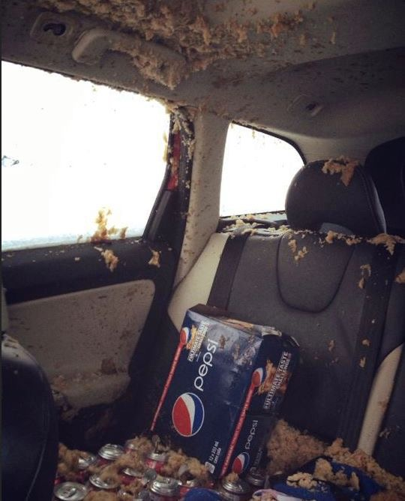
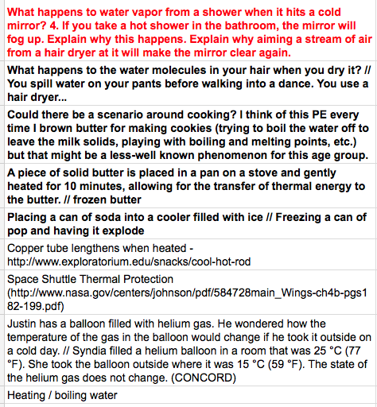
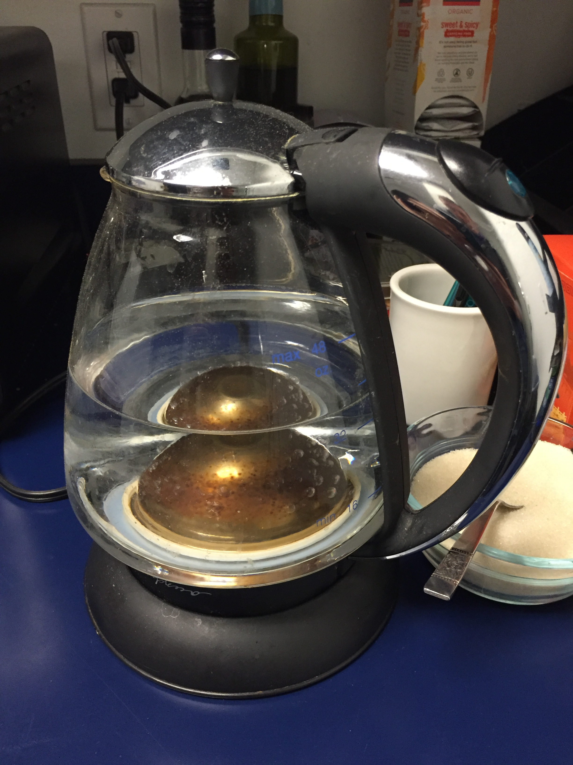
Sample Scenario Brainstorm
Notes:
This is the brainstorm of possible scenario contexts that the Seattle & Renton project generated for their learning performance—before they settled on the “Fogged Mirror” scenario. They used the criteria for scenario to settle in on it. Note the initial framing (in red) in comparison with the final description of the scenario on the student sample.
[estimated time: 2 minutes]

Slide 33
STEP 3: Brainstorm Scenarios
Criteria for an assessment scenario…
It should allow students from non-dominant communities (e.g., ELLs, students from poverty-impacted communities, differently abled) to fully engage with the task. We should design for them first!
It should involve a compelling phenomena related to one or more of the DCIs being assessed—and not feel like a test-like task. It should beg for explanation! Make it more like an anchoring phenomena for an awesome, month-long unit.
It should lend itself to a broad range of the science and engineering practices.
It must be understandable quickly by students. For this reason, selecting everyday situations can be useful.
Notes:
Assessment scenarios themselves can be a major source of inequity.
In the Introduction to Formative Assessment PD Session (see pd modules on stemteachingtools.org), we described these criteria for the selection of assessment scenarios. Assessment scenarios need to be quickly understandable by as many students as possible. Often specific scenarios from everyday life are culturally unfamiliar to some students.
((Ask the room to read the criteria))
It is ideal to test out assessment scenarios with your actual students. As you think about the one you worked on today, you might want to refine or adjust it to make it more fair.
Talk through some counter examples eg. Anything involving elite activities such as skiing.
Refer to these criteria as you brainstorm possible scenarios for your task.
[estimated time: 2 minutes on slide; 5 minutes work time to brainstorm scenarios]

Slide 34
STEP 3: Choose a phenomenon or a design challenge for the task
Select one scenario to work with today and bold it in your Google workspace.
Notes:
((Read slide))
We want to focus on designing an assessment you can use immediately and one that “gets after” a small piece of the standard.
((Use next two slides if you want to provide an example—and then come back to this slide. Ask people to use their worksheet to track their work.))
[estimated time: 5-10 minutes with work time]

Slide 35
STEP 4: Write a complete student explanation of the phenomenon or solution to the design challenge
Read the STEP 4 description on STT#29 and follow the instructions.
Notes:
((Read slide))
We want to focus on designing an assessment you can use immediately and one that “gets after” a small piece of the standard.
((Use next two slides if you want to provide an example—and then come back to this slide. Ask people to use their worksheet to track their work.))
[estimated time: 5-10 minutes with work time]

Slide 36
STEP 5: Use the Science and Engineering Practices and Crosscutting Concepts Tools to develop individual prompts
Develop a sequence of prompts (i.e., 2D and 3D components) for your task. Think of them as a flow of sequential phases of an investigation. Use a variety of practices that make sense.
Notes:
((Read slide))
We want to focus on designing an assessment you can use immediately and one that “gets after” a small piece of the standard.
((Use next two slides if you want to provide an example—and then come back to this slide. Ask people to use their worksheet to track their work.))
[estimated time: 5-10 minutes with work time]

Slide 37
Assessment Task Formats for the Practices
We created a collection of task formats for the science and engineering practices that help with the design of assessment components. They can also be used to guide instruction.
STEMteachingtools.org/brief/30
Notes:
The science and engineering practices are a central element of the 3D learning model—they are the foundation on which conceptual knowledge is developed and applied. They are the means by which students make sense of natural phenomena—or build solutions to problems—through sustained investigations.
((Read slide))
[estimated time: 30 sec]

Slide 38
Task Formats for Developing & Using Models
Notes:
This tool offers between four and eight possible task formats for each of the science and engineering practices listed in the NRC Framework / NGSS. The task formats can give you specific ideas about how to craft assessment questions that engage students in the practice in question. The task formats are roughly ordered from less to more cognitively complex. Think of them as like blueprints for developing tasks that require students to engage in a practice to show what they know.
[estimated time: 15 sec]

Slide 39
Prompts for Assessing Cross-Cutting Concepts
STEMteachingtools.org/brief/41
Notes:
Similarly, cross-cutting concepts are another dimension of the 3D learning model. This STEM Teaching Tool helps you design questions about this dimension.
[estimated time: 15 sec]

Slide 40
Prompts for Assessing Cross-Cutting Concepts
STEMteachingtools.org/brief/41
Notes:
This tool highlights prompts that can be used in assessments or in classroom conversation to support the learning and application of these cross-cutting concepts that show up across the disciplines of science and engineering. These are some of the prompts for Cause and Effect.
[estimated time: 15 sec]

Slide 41
STEP 5: Use the Science and Engineering Practices and Crosscutting Concepts Tools to develop individual prompts
Read the STEP 5 description on STT#29 and follow the instructions.
Notes:
((Read slide))
We want to focus on designing an assessment you can use immediately and one that “gets after” a small piece of the standard.
((Use next two slides if you want to provide an example—and then come back to this slide. Ask people to use their worksheet to track their work.))
[estimated time: 5-10 minutes with work time]

Slide 42
STEP 6: Integrate questions to assess student interest and identification with science and engineering presented in the scenario
Read the STEP 6 description on STT#29 and follow the instructions. Add the new prompts to your flow of prompts from STEP 5.
Notes:
((Read slide))
We want to focus on designing an assessment you can use immediately and one that “gets after” a small piece of the standard.
((Use next two slides if you want to provide an example—and then come back to this slide. Ask people to use their worksheet to track their work.))
[estimated time: 5-10 minutes with work time]

Slide 43
STEP 7: Develop ideal student answers and a scoring guide
Read the STEP 7 description on STT#29 and follow the instructions.
Notes:
((Read slide))
We want to focus on designing an assessment you can use immediately and one that “gets after” a small piece of the standard.
((Use next two slides if you want to provide an example—and then come back to this slide. Ask people to use their worksheet to track their work.))
[estimated time: 5-10 minutes with work time]

Slide 44
STEP 8: Review your task with peers for intelligibility, alignment, and accessibility
Read the STEP 8 description on STT#29 and follow the instructions.
Notes:
((Read slide))
We want to focus on designing an assessment you can use immediately and one that “gets after” a small piece of the standard.
((Use next two slides if you want to provide an example—and then come back to this slide. Ask people to use their worksheet to track their work.))
[estimated time: 5-10 minutes with work time]

Slide 45
STEP 9: Pilot and revise your assessment
On your own! Develop, test, analyze& refine. Iterate, iterate, iterate
Notes:
((Read slide))
We want to focus on designing an assessment you can use immediately and one that “gets after” a small piece of the standard.
((Use next two slides if you want to provide an example—and then come back to this slide. Ask people to use their worksheet to track their work.))
[estimated time: 5-10 minutes with work time]

Slide 46
Reflection
The most powerful phenomena in instruction are personally relevant or consequential to students. Such phenomena highlight how science ideas help us explain aspects of real-world contexts or design solutions to science-related problems that matter to students, their communities, and society.
The same is true for assessment scenarios that involve phenomena you want students to reason about. Has that been your experience?
Notes:
((Have participants read slide and reflect on the question—and discuss it.))
[estimated time: 3 minute]

Slide 47
STEP 2: Workshop the Scenarios
What the leading scenarios you think relate to your learning performance? Describe how.
Relate the criteria to the leading scenarios. Does it centrally focus on relevant phenomena? How interesting and relevant might each be to your students? Are there confusing cultural components?
After the discussion, select the best scenario and craft student-facing language for it. It should be lean, but clear. Perhaps include a clarifying picture or diagram.
Notes:
In a group worshop format, share out leading (2-3) scenario ideas from individual or paired work, reflect on them using the questions and criteria. Work towards helping people identify the “best” (relevant, workable, fair) scenario that they should focus on.
((After the discussion, have people select the best scenario and write a student-facing description of it.))
You may want to intentionally include “distractors” in the scenario that you want students to rule out—but typically not.
((These could be shared and workshopped again if time allows.))
Reflect on your scenario identification process. What did you learn about how to go about that?
[estimated time: 15-20 minutes]

Slide 48
Take-Aways
What did you learn about identifying a scenario so that it is relevant, clear, and fair?

Slide 49
STEP 4: Define a 3D Learning Performance
Notes:
Now we are going to pull together the work so far and formalize our 3D learning performance.
Remember here that learning performances are the way in which we clarify intended learning. Learning performances are at the scale of lesson planning, this practice is sometimes called establishing learning targets, learning claims (STT 29), learning goals or learning objectives.
[estimated time: 30 sec]

Slide 50
3D Learning Performances: Lesson-Level Learning Goals
How will you know if my students are making progress toward the unit-level bundle of performance expectations?
3D Learning Performances are specific ‘knowledge-in-use’ statements that include aspects of a disciplinary core idea, a practice, and a crosscutting concept from the bundle
They are smaller in scope than a PE
Background: nextgenscienceassessment.org
Notes:
((READ SLIDE to clarify 3D learning performances))
[estimated time: 1 minute]

Slide 51
Constructing a Set of 3D Learning Performances Across a Unit
Crosscutting Concepts
By unpacking PEs, identify key component(s) of…
disciplinary knowledge
science & engineering practices
cross-cutting concepts
Construct statements or “assessment claims” of what a student should be able to do
Background: nextgenscienceassessment.org
Disciplinary Core Ideas
Practices
Notes:
((READ SLIDE))
[estimated time: 2 minutes]

Slide 52
Share & Refine
What 3D Learning Performances did you come up with? Can we all identify the three dimensions?
How might we refine them to improve them?
Notes:
((After participants have worked up some examples, talk through them as a group thinking and refine them to be more 3D.))
[estimated time: 5-10 minutes]

Slide 53
STEP 5: Build 2D and 3D Questions (Items)
Start with either your selected SEP or CCC. Use…
science and engineering practices task formats or
crosscutting concept prompts
Consider how are you connecting the chosen SEP and/or CCCs to the disciplinary concept (DCIs).
STEMteachingtools.org/brief/30
STEMteachingtools.org/brief/41
Notes:
Now that you have your 3D learning performance use the specific task format for your SEP and the specific prompt structures from your CCC you selected in step 3 to write out possible questions that go with the task. You can start with either the SEP or the CCC and then build it together with the other.
Remember: Student responses should give you evidence that you can use to guide your instructional choices. You are steering students towards deeper understanding through sense-making by engaging in formative assessment. You are not simply trying to see if they have the “right idea” or not. You are trying to make their thinking visible.
[estimated time: 10-15 minutes]

Slide 54
STEP 6: Imagine Student Responses
Read through your drafted question(s) and imagine how students might answer at three levels: (1) limited, (2) partial, and (3) full understanding. For the full understanding response, you should imagine the response an ELL student with deep conceptual understanding would provide.
Think of common facets of student thinking that might result from the cultural and experiential backgrounds of your students.
How might revisions to your questions/items:
elicit this variation in student thinking?
identify linguistic challenges facing students?
Notes:
((READ SLIDE))
((Give groups time to craft student responses. If your context allows, it is more powerful to pilot the assessment with students and get their response. If that does not make sense, you can ask teachers to “role play” responding based on a variety of specific students.))
((BACKGROUND: STEM Teaching Tool #37 provides a background on the idea of “facets” of student thinking.))
[estimated time: 2-6 minutes]

Slide 55
STEP 7a: Share, Review & Revise
Share your 3D classroom assessment with another individual / group and look over theirs to provide 3D feedback. Here are a few things to consider:
What is the “3Dness” of the items (or clusters)? Can you identify the focal DCI, SEP, and/or CCC?
Are there words that students would find confusing or misinterpret? Would a visual of some kind add clarity?
Would the assessment give you “actionable evidence” to guide instruction?
Is the scenario accessible to all students?
Is the scenario relevant and engaging to students? Is it a fair assessment task?

Slide 56
STEP 7b: Share, Review & Revise
Post your 3D daily classroom assessment around the edge of the room.
Take a walk through the gallery of assessment tasks.
With your colleagues, discuss specific tasks and reflect on what you learned (or struggled with) as you crafted your 3D classroom assessment.
Notes:
((Optional activity: Whole group review process. If you want to share out using a gallery walk and then have people use post-its to mark suggested revisions to the assessments considering questions on prior slides. You can end the session by discussing insights about assessment development itself—or have participants write their insights about that on stickies and have a curated discussion of them with the room.))
[estimated time: 5-15 minutes depending on number of shares]

Slide 57
The Formative Assessment Process, Revisited (from Beth Simpson & Amber McCulloch)
Clarify
Intended
Learning
Evidence
Elicit
Act on
Evidence
Interpret
Evidence
Notes:
The Formative Assessment process can be understood as involving four steps. ACESSE Resource A deeply describes this process with a worked example.
Today we are focused on designing a written cognitive assessment that elicts evidence of how students understand the learning goals associated with 3D performance expectations. We will have to also spend some time clarifying the intended learning goals that are the focus of the assessment task we will craft.
Recall: With cognitive formative assessment, we are focused on surfacing the learning resources that students bring to an instructional moment. In ACESSE Resource E, we highlight how “facets of student understanding” can be identified—and used to guide instruction. We should not be looking for how students might be wrong (i.e., identifying misconceptions). We are trying to recognize the range of ideas students bring to sense-making so we can help them refine them.
From a cognitive formative assessment perspective, ACESSE Resource E focuses on the bottom of the clover leaf—how to interpret the range of student thinking and act on it in instruction.
From a cultural formative assessment perspective, ACESSE Resource C shows how to focus instruction on the interests, knowledge, and identities of students and their communities. That half-day session goes through the full clover leaf process. This is a strategy for supporting culturally relevant and sustaining instruction.
[estimated time: 2 min]

Slide 58
Session Reflection
How can 3D Learning Performances help you map out a series of formative assessment events across a unit that you teach?
After focusing closely on the three dimensions of science learning, what implications for your teaching occur to you?
Notes:
((READ SLIDE; Ask participants to write, state, or discuss some reflections on the core learning goals of the session.))
[estimated time: 5-10 minutes]

Slide 59
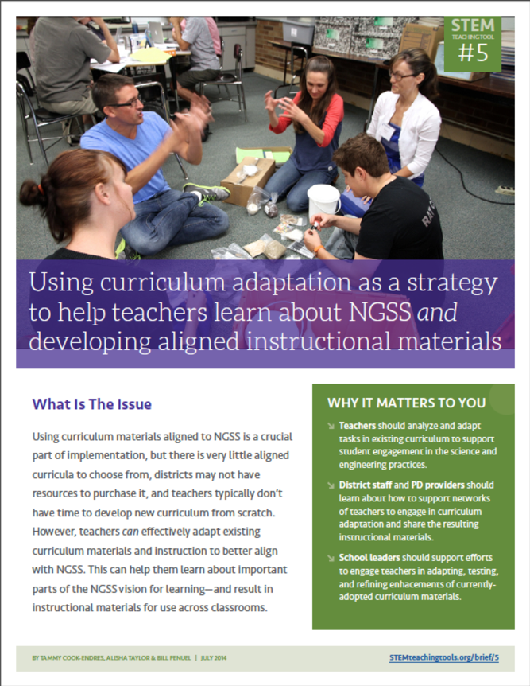
Professional Learning Resources to Support NGSS Implementation
Co-designed by practitioners & researchers
Tested & refined over time
Easily shareable—over social media, email, paper
STEMteachingtools.org (web)
@STEMteachtools (twitter)
pinterest.com/stemeducation (pinterest)
Notes:
You will be able to find ACESSE resources and other tools on the STEM Teaching Tools site. You can easily download PDFs of dozens of tools to support implementation of the NRC Framework vision.
[estimated time: 30 sec]

Slide 60
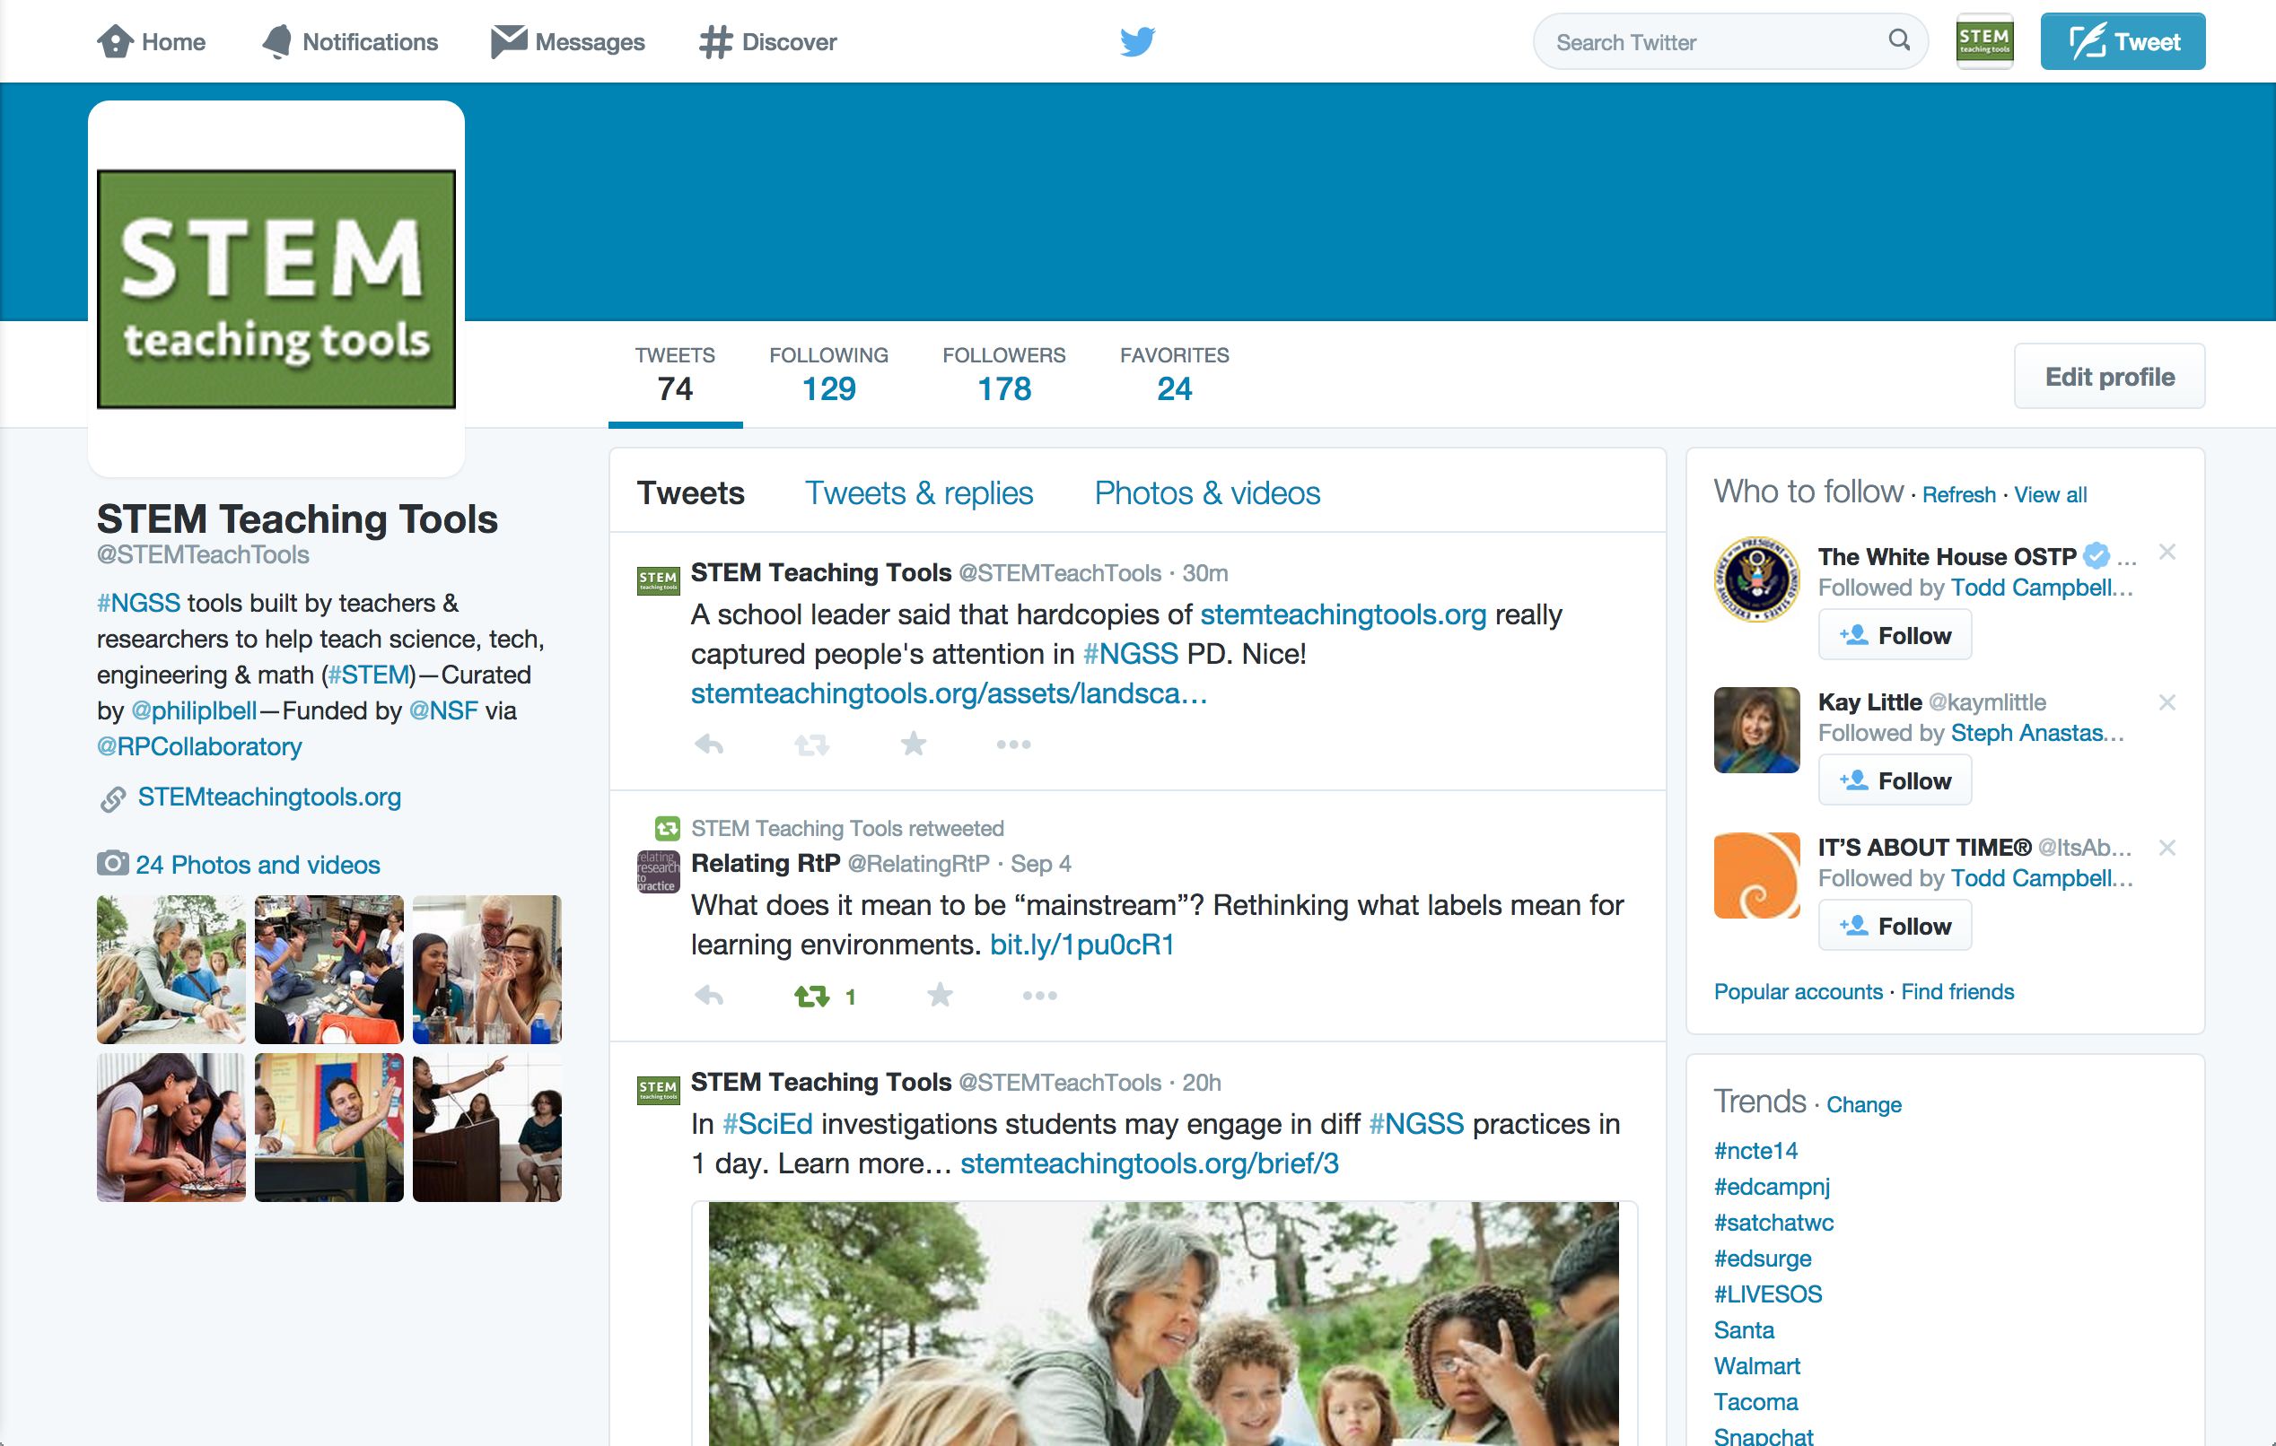
On Twitter @STEMTeachTools
Notes:
You can learn about these tools on Twitter.
[estimated time: 30 sec]

Slide 61
Sign Up for Email Newsletter STEMteachingtools.org
Notes:
Or sign up for a periodic email newsletter—at the bottom of the front page of the web site.
[estimated time: 30 sec]

Slide 62
Image of three teachers working on curriculum, with the title "OER PD Resources for NGSS" and the url stemteachingtools.org/pd and the STEM Teaching Tools logo.
Notes:
All of the STEM Teaching Tools and ACESSE resources have been developed as Open Education Resources (OER). Please adapt them for your local uses.
[30 seconds]

Slide 63
Help us improve the resource
Please take this 5 minute survey to help the ACESSE team improve this resource for others. http://tinyurl.com/ACESSE-D
Notes:
((READ SLIDE and ask participants to complete the survey. Clarify that this is information for the ACESSE team to refine the activities—and not about you as the facilitator.))
[estimated time: 3-5 min]

Slide 64
Thank you! For more info…
Resources
STEM Teaching Tools STEMteachingtools.org @STEMTeachTools (twitter)
Other ACESSE OER PD Modules STEMteachingtools.org/PD
Formative Assessment “Short Course” tinyurl.com/Science-3D-assessment-course
Contact Us
Philip Bell pbell@uw.edu @philiplbell
Deb Morrisson eddeb@uw.edu @educatordeb
This resource was developed through the ACESSE project funded by the National Science Foundation (NSF) through Award DRL-1561300 and the Research + Practice Collaboratory funded by NSF through DRL-1626365. The opinions do not represent those of the funder.
Notes:
Here are some resources and contact information for the authors of this PD unit. They hope you have found it useful. They welcome any feedback or suggestions on how to improve it.
[estimated time: 30 sec]
((This resource was refined through a 13-state collaboration to make the resource more broadly useful. If you choose to adapt these materials, please attribute the source and that it was work funded by the National Science Foundation (NSF).))

