Slide 1
Learning to See the Resources Students Bring to Sense-Making
Philip Bell, University of Washington
Megan Bang, Northwestern University
Enrique Suárez, Deb Morrison & Gina Tesoriero, University of Washington
Lauren Johanna Kaupp, Council of State Science Supervisors
With many contributions from the ACESSE Network
February 2019
This work is licensed under a Creative Commons Attribution-ShareAlike 4.0 Unported License. Educators and others may use or adapt. If modified, please attribute and re-title. CC BY-SA license details are at https://creativecommons.org/licenses/by-sa/4.0/
Notes:
In this workshop, we will build our capacity to identify the range of intellectual resources students use as they make sense of phenomena. We will first explore how equity and justice relate to culture-based approaches to pedagogy—and then focus on how to identify and leverage the resources students use in moments of sensemaking.
[estimated time: 2 min]
((There is a Facilitator’s Guide available for this resource: http://tinyurl.com/ACESSE-ResourceG-Guide ))
((This resource was refined through a 13-state collaboration to make the resource more broadly useful. If you choose to adapt these materials, please attribute the source and that it was work funded by the National Science Foundation (NSF).))

Slide 2
Overview of the Session Goals
Explore equity dimensions of sense-making through the science and engineering practices.
Learn to see different ways students contribute to making sense of phenomena—and connect to science.
Better appreciate that navigating multiple ways of knowing is the basic human condition—not the exception (Bang, 2018).
Make a commitment to shape instruction to supports diverse sense-making.
Notes:
There are four goals for this session… ((READ SLIDE))
One thing to note explicitly is that this session is not about developing a product so much as it is about building the interpretive power of teachers to see student resources and connect them to sense-making and sense.
[estimated time: 1 minute]

Slide 3
A Few High-Level Reminders...
Teaching is as complex as any other profession. Expertise in teaching continues to develop for decades.
Strategic, incremental shifts in practice—with support and feedback from others—is the best way to refine your teaching. Continue being experimental and collaborative.
Promoting uniformity (e.g., in curriculum, assessment, instruction,…) is in direct tension with fundamental human cultural diversity and geographic specificity. Build capacity to attend to differences!
Notes:
As we learn a new aspect of teaching practice, I think a few high-level reminders are helpful to motivate and guide this work.
((READ SLIDE))
[estimated time: 1 minute]

Slide 4
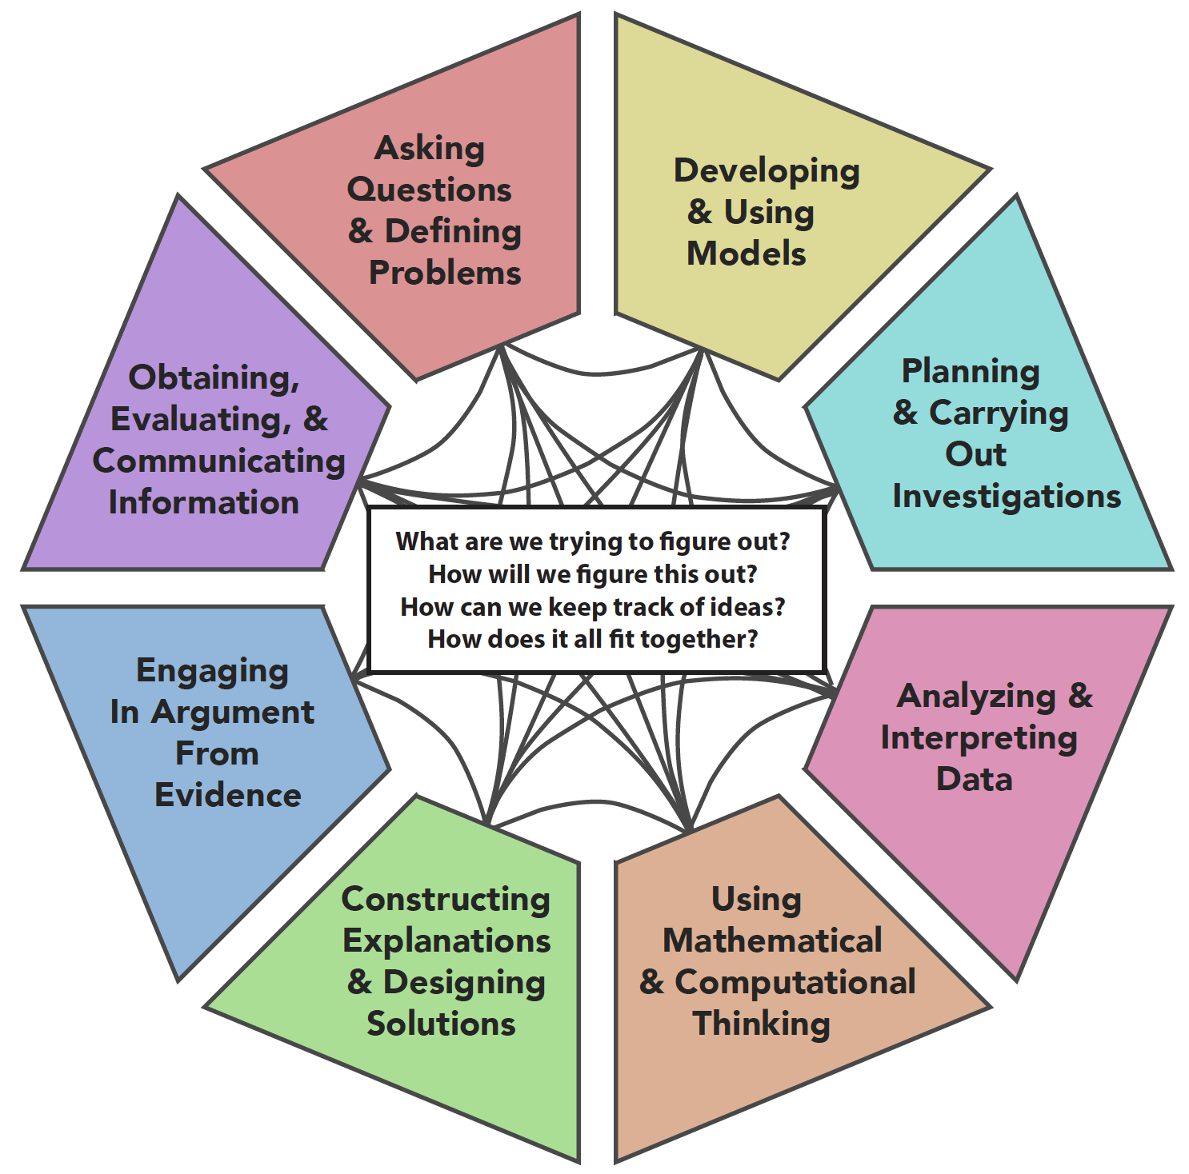
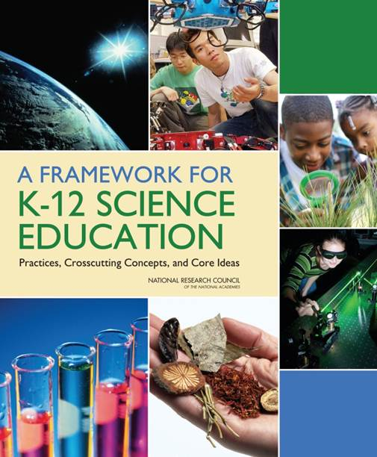
Learners Make Sense of Phenomena Through Science & Engineering Practices
Notes:
The science and engineering practices support sense-making. They are a game changer—they put students in positions of being knowers, doers, and makers. Students flow between different practices in ways that respond to making progress in their unfolding investigation. This is a representation of that process. The science and engineering practices can powerfully support learning if they are configured to be inclusive.
[estimated time 3 min]

Slide 5
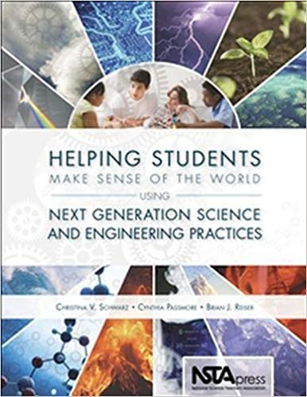
The Potential of the Science & Engineering Practices
“Realizing [the] potential of [the practices] is particularly important in relation to students of color, students who speak first languages other than English, and students from low-income communities who, despite numerous waves of reform, have had limited access to high-quality, meaningful opportunities to learn science.”
—Bang, Brown, Calabrese Barton, Rosebery & Warren (2017, p. 34)
Notes:
The central focus on science and engineering practices in the 3D model of science learning in the NRC Framework has a huge equity potential.
((READ SLIDE))
This session will show how to provide invitations to students to share their reasoning and sensemaking approaches as part of the practices involved in investigations.
[estimated time 1 min]

Slide 6
Equity & Justice Quick Write
What is your leading theory or explanation for educational inequity in science?
Notes:
Let’s think about the students and communities we serve.
((READ SLIDE & HAVE INDIVIDUALS DO QUICK WRITE — AND THEN HAVE TABLE GROUPS OR ELBOW PARTNERS TALK))
((DEBRIEF DIMENSIONS AND EXAMPLES WITH THE ROOM))
[estimated time: 10-15 min]
((Suggestion: Some individuals and groups may be hesitant to share their perspective. It is a good time to remind the educators that it is likely very similar to when our students hesitate when talking about a challenging topic like equity in the classroom; we should remember that and realize that we need to help create a learning community that can engage in important conversations like that.))

Slide 7
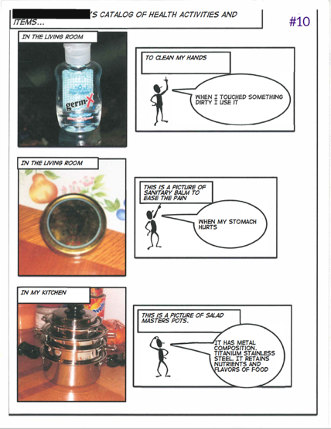
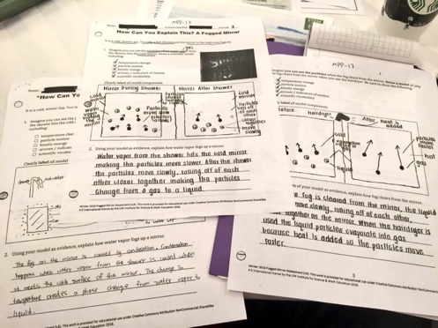
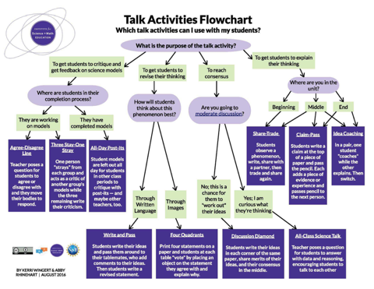
Equitable Science Instruction from NRC Framework Chapter 11
Learning is cultural. Instruction should grow out of everyday experience of learners and connect to their interests and identities.
Instruction should leverage science-related values, knowledge, and practices of students, their families, and cultural communities.
Instruction should allow students to bring their full communicative resources to bear on the situation.
Notes:
This is a summary of the Equity and Diversity chapter in the NRC Framework.
((READ SLIDE AND CLICK FORWARD TO SHOW IMAGES—MAKE CONNECTIONS BACK TO THE EQUITY LIST JUST GENERATED—AND MENTION THAT THERE ARE STRATEGIES TO GO WITH DIFFERENT DIMENSIONS.))
[estimated time: 30 sec]
((Background: The resources shown come from the STEM Teaching Tools initiative, http://stemteachingtools.org/ ))

Slide 8
Reminder: All Science Learning is Cultural
“Human beings, no matter who we are, where we live, or what language we speak at home, develop our ways of knowing, talking, valuing, and acting as we live our day-to-day lives inside family and community. These ways of living are what is now understood as culture. Indeed, across communities, human beings make sense of the world in ways that are both similar and different.”
—Bang, Brown, Calabrese Barton, Rosebery & Warren (2017, p. 35)
Notes:
The NRC Framework highlights that all science learning is a cultural accomplishment. Let’s review a definition of “culture” to keep that idea centered in our thinking today.
((READ SLIDE))
How students observe phenomena, interpret it, explain it, shape it, and how they learn from others and what they value and fundamentally how they think about the universe—are all culturally shaped by the communities they are part of.
[estimated time 2 min]

Slide 9
Small Group Discussion
What does it look like when students make sense of phenomena? Describe it. How do you make sense of the phenomena in your world?
Notes:
Think about the students and communities you serve.
((READ SLIDE & HAVE TABLE GROUPS OR ELBOW PARTNERS TALK))
((DEBRIEF DESCRIPTIONS WITH THE ROOM))
[estimated time: 10 min]

Slide 10
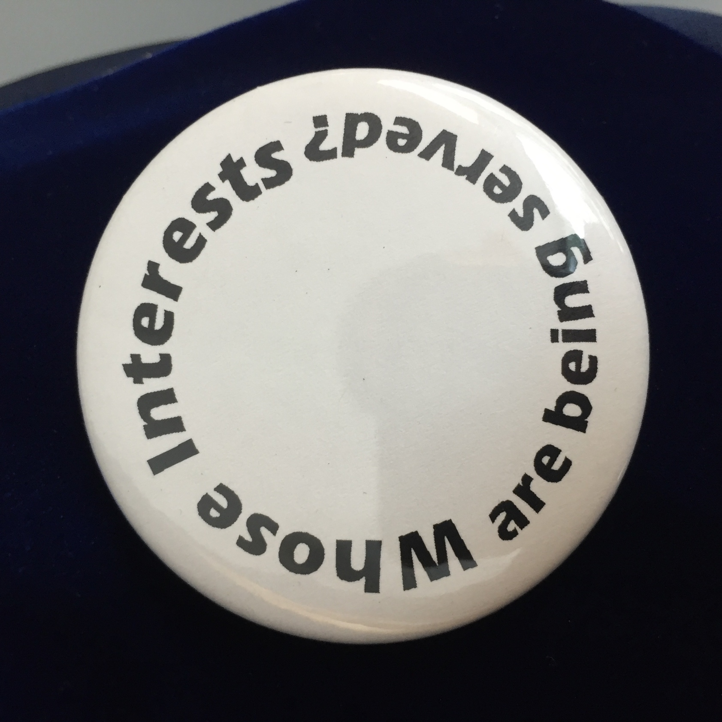
Image of button: Whose Interests are Being Served
Notes:
As we find our way into thinking about the ways we judge the contributions and responses that come from students, it is crucial to remember “Whose interests are being served?” based on how we respond to those contributions. Whose contributions are we ruling “out of bounds” for being related to science or to a moment of sense-making—and which are “on the mark”? And what criteria are in play at that moment.
Of course, this question is broadly useful as educational decisions happen and initiatives unfold.
[estimated time: 1 minute]

Slide 11
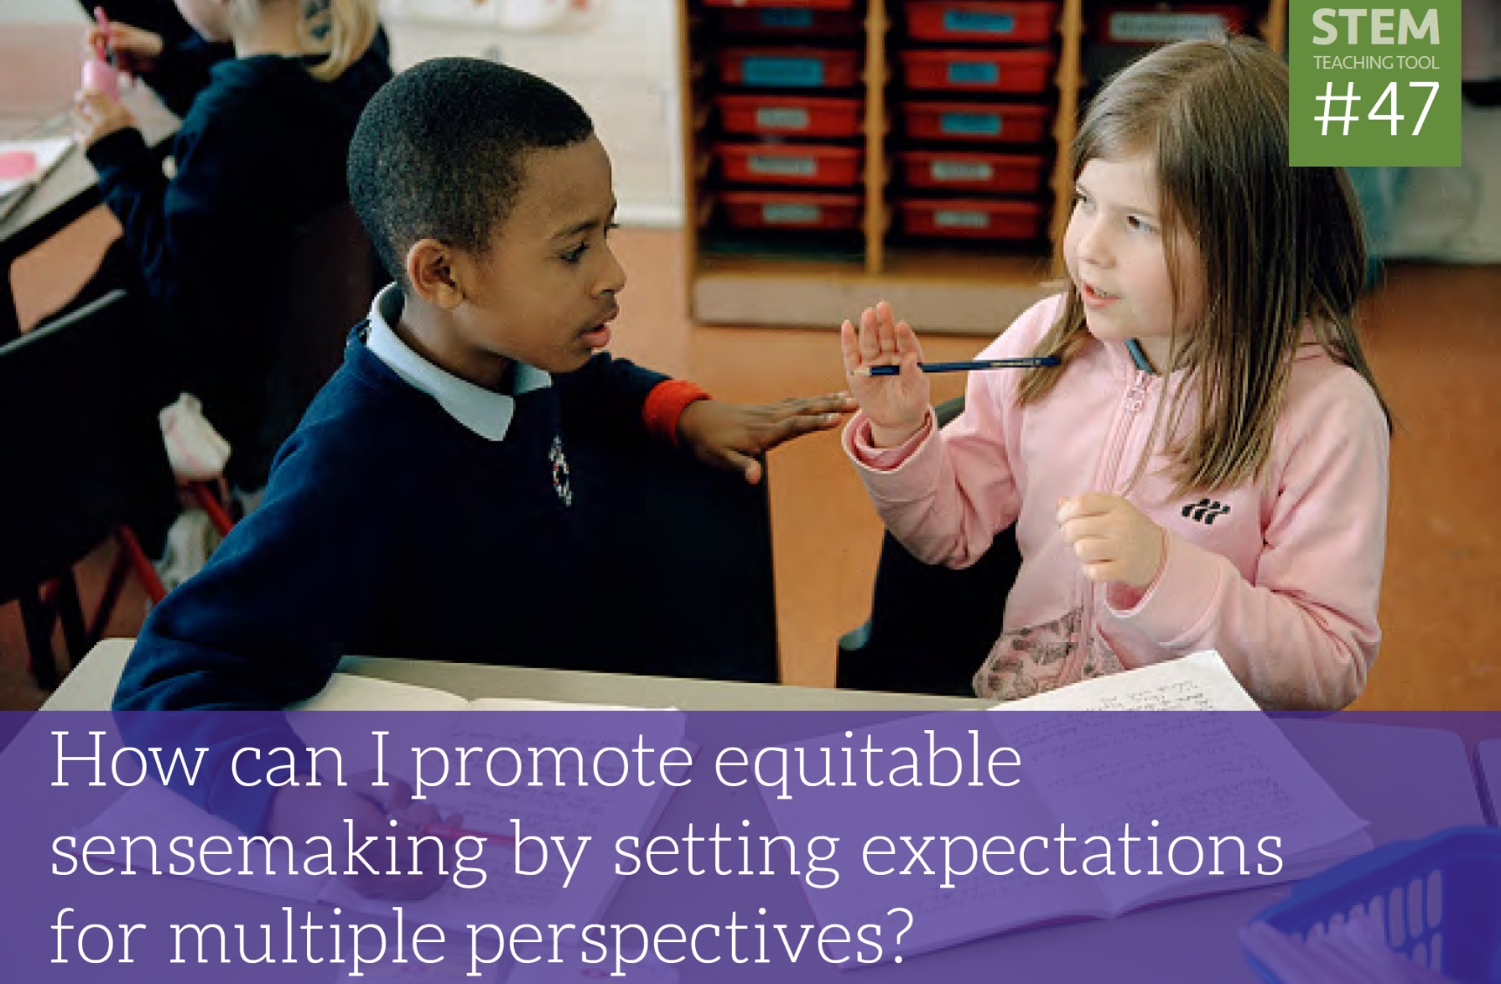
STEMteachingtools.org/brief/47
Notes:
Sense-making is a complex process. Let’s make some sense of it. Read this brief and discuss any questions or insights that come up for you.
[estimated time: 8-10 minutes]

Slide 12
A Major Take-Away
“Creating equitable learning opportunities depends critically on teachers’ skill in seeing and hearing students’ ideas and reasoning as connected to science (as opposed to being off topic, or, worse, disruptive).”
—Bang, Brown, Calabrese Barton, Rosebery & Warren (2017, p. 36)
Notes:
((READ SLIDE))
This is the main take away. Teachers routinely navigate moments where they make the quick decision about whether or not a student response or contribution is relevant to a given moment of sensemaking. These are crucial equity moments. We must work to try and connect those contributions to the science involved in a moment—even if we don’t immediately understand it. Ask for clarification if you need it. Ask another student to explain the idea another way so you can see the connection. Sink in.
Be generous and open to what students bring to a moment. We know that language may not be clear as people sort through their ideas—this is true for everyone learning a new complicated subject. Assume positive intent, positive contribution. Sink in.
[estimated time 3 min]

Slide 13
Conceptual Charades!
Ground rule: Hint-giver may not speak or write in English.
Notes:
Let’s play a game. We need to learn to see the sense-making resources of others. This game of conceptual charades is a great way to do that. Some of you might not have played charades before. One person at each table will be trying to get the rest of you to guess a specific concept.
The one ground rule is that the hint giver cannot speak or write in English. Anything else is fair game.
You should identify a person at your table to be the hint-giver. ((WAIT 15 SECONDS)) Everyone else should close their eyes. I’m going to show the clue in 3 – 2 – 1…
((ADVANCE SLIDE))
[estimated time: 2 min]

Slide 14
Light Reflection
Notes:
((SHOW THIS SLIDE UNTIL ALL HINT-GIVERS SEE IT))
[estimated time: 30 seconds]

Slide 15
Charade!
Notes:
And Charade!
((WAIT UNTIL THE GROUPS ARE DONE))
Did anyone use the standard charade signals to be successful? Did it let you finish more quickly? If so, that is a cultural assumption you are taking advantage of. What cultural assumptions do students bring to the classroom that give some an advantage in classroom conversations.
Ok – so don’t use charade signals this time… You should identify a new person at your table to be the hint-giver. ((WAIT 15 SECONDS)) Everyone else should close their eyes. I’m going to show the clue in 3 – 2 – 1…
[estimated time: 5 min]

Slide 16
Photosynthesis
Notes:
((SHOW THIS SLIDE UNTIL ALL HINT-GIVERS SEE IT))
[estimated time: 30 seconds]

Slide 17
Charade!
Notes:
And Charade!
((WAIT UNTIL THE GROUPS ARE DONE))
Did anyone use a different language to communicate with their table? You were only told not to use English. Did you think to use a different language? What other communication resources do you have?
You should identify a new person at your table to be the hint-giver. ((WAIT 15 SECONDS)) Everyone else should close their eyes. I’m going to show the clue in 3 – 2 – 1…
[estimated time: 3 min]

Slide 18
Energy Transfer
Notes:
((SHOW THIS SLIDE UNTIL ALL HINT-GIVERS SEE IT))
[estimated time: 30 seconds]

Slide 19
Charade!
Notes:
And Charade!
((WAIT UNTIL THE GROUPS ARE DONE AND DEBRIEF THE GAME))
Let’s debrief the game for a minute.
What are all of the different resources people ended up using? How was this experience similar and different than listening to a classroom discussion? Is there something we can learn from this stance of deeply trying to understand another?
Let’s bring this open, generous stance to communication resources as we learn to see the range of resources that students use in learning situations.
[estimated time: 5 min]

Slide 20
Taking an Asset Approach to Learner Cultural Diversity
Notes:
Now let’s open up some dimensions of equity and justice in the context of science teaching.
[estimated time: 15 seconds]

Slide 21
Learners Make Sense of Phenomena Through Science & Engineering Practices
Curriculum and assessment often promote very narrow views of “what counts” as desired ways of speaking, knowing, acting, and valuing.
We need to broaden what counts as learners make sense of phenomena—especially for multilingual students, students of color, and students from low-income communities.
Notes:
Let’s revisit the science and engineering practices.
((CLICK TO GET THE YELLOW TEXT—AND READ))
We need to work in instruction to keep the practices broadly inclusive to the cultural variation in our learning community. It is powerful to think of a practice—like modeling—as an invitation for students to show you how they represent system, its relationships, and its dynamics. It should be a process of getting them to relate, reveal, and refine their ways of knowing.
[estimated time 3 min]

Slide 22
Three principles towards more equitable science education
Principle 1: Notice sense-making repertoires. Consider students’ diverse sense-making as connecting to science practices.
Principle 2: Support sense-making. Support students to use their sense-making repertoires and experiences as critical tools in engaging with science practices.
Principle 3: Engage diverse sense-making. Students’ scientific practices and knowledge are always developing and their community histories, values, and practices contribute to scientific understanding and problem solving.
From: Bang, Brown, Calabrese Barton, Rosebery & Warren, Toward more equitable learning in science, In Helping students make sense of the world using next generation science and engineering practices, NSTA.
Notes:
((HANDOUT THE PRINCIPLES))
These are the three equity principles from the equity chapter in the NSTA practices book. They are a powerful set of general principles for expansive teaching.
((READ THE PRINCIPLES—PERHAPS JUST HEADINGS WITH VERBAL SUMMARIES OF THE DETAILS))
[estimated time 3 min]

Slide 23
STEMteachingtools.org/brief/11
Notes:
Let’s explore a specific case by reading this STEM Teaching Tool.
((ASK THE ROOM TO READ THE TOOL))
((DEBRIEF THE RELEVANT SUBSTANCE—IDENTIFY THE RELEVANT RESOURCES: the focus on close observation of phenomena, the central role of storytelling in explanation and modeling, place-based knowledge of ecosystems))
[estimated time: 5 min]

Slide 24
Expanding Relationships Among Students, Teachers & Science Practices
“The bottom line is, the more you show genuine intellectual and scientific interest in your students’ sense-making [of phenomena], the more you expand the space of possible relations among you, your students, and science.”
—Bang, Brown, Calabrese Barton, Rosebery & Warren (2017, p. 34)
Notes:
Teachers need to be in intellectual relationships with each of their students. If they aren’t, how can we expect students to learn and come to identify with science. Developing relationships is hard—but rewarding—work.
((READ SLIDE))
Recognizing the assets that students bring to sensemaking is a powerful way to develop these intellectual relationships.
[estimated time 3 min]

Slide 25
A Model for Conversation-Based Formative Assessment
Teacher Elicits Response
Student
Responds
Teacher Uses
Student Response
Teacher Recognizes Student Response
Figure 1. The ESRU model of informal formative assessment.
From: Ruiz-Primo, M. A., & Furtak, E. M. (2007). Exploring teachers’ informal formative assessment practices and students’ understanding in the context of scientific inquiry. Journal of Research in Science Teaching, 44(1), 57-84.
Notes:
As we pretend to do an “on the fly” interpretation of student resources, here’s a formative assessment model that is useful to keep in mind.
((TALK THROUGH THE MODEL))
How does it relate to how you do classroom assessment?
[estimated time 5 min]

Slide 26
STEMteachingtools.org/brief/16
Notes:
To learn more about this model, this STEM Teaching Tool describes this framework for conversation-based formative assessment. It Is closely related to what we will be doing in a moment. I encourage you to explore it as a follow-on activity.
[estimated time 30 sec]

Slide 27
Assessment is often talked about as an instrumental practice focused on monitoring learning or motivating educational achievement.
If caring is thought of as a way to make yourself more susceptible to some matters than others, assessment can be a caring practice (Bell, 2018). It is a way to focus instruction on learner voice, knowledge, perspective, and contribution. We can come to be more responsible to diverse learner contributions. In the process, this caring stance can support building crucial intellectual relationships with students.
Notes:
We should engage learners in understanding why we do formative assessment—through our words and our actions. Assessment can be part of the process of developing a trusting intellectual relationship with your students.
((READ SLIDE))
[estimated time: 3 min]

Slide 28
Learning to See Cultural Sense-Making Repertoires What are the sense-making resources that learners are showing evidence of in each of the following learning scenarios?
Notes:
We are going to closely look at a series of learning scenarios (situations). Here’s our guiding question for each one:
((READ SLIDE))
[estimated time: 30 sec]

Slide 29
Facilitator Instruction Slide
You won’t likely have time to work through all of the scenarios included in this deck. You should review the pairs of slides for each scenario and prioritize the ones that fit your purposes by re-ordering them and hiding slides.
Notes:
Hidden Facilitator Instruction Slide

Slide 30
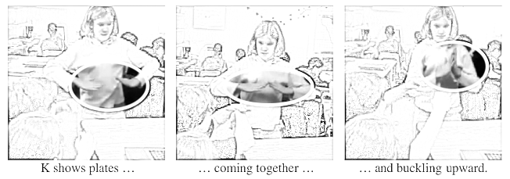
The Plate Tectonics Scenario
Sixth grade students are studying plate tectonics using a data visualization tool. As students work to make sense of key concepts — subduction, rift, and buckling — they use their hands to express their developing conceptual models before they are able to describe them in speech. Once the models appear in speech, speech and gesture used together figured prominently in the further elaboration, modification, and refinement of the concepts. Students often compared and negotiated their understanding with their hands.
Hint: Do you always have to use words to represent and communicate a conceptual model?
Singer, M., Radinsky, J., & Goldman, S. R. (2008). The Role of Gesture in Meaning Construction. Discourse Processes, 45(4-5), 365-386.
Notes:
((READ THE SCENARIO; SEE IF PEOPLE NEED ANY CLARIFICATION))
At your tables, look for evidence of each kind of sense-making resource you see. Be ready to share what you identify. After you are done with that, think through if that kind of resource is something you’ve seen in your teaching.
((AFTER A MINUTE OR SO, CLICK TO REVEAL THE CLUE TO THE ROOM))
((START DEBRIEFING WITH THE ROOM ABOUT THE SENSE-MAKING RESOURCES THEY IDENTIFIED))
((TRANSITION TO NEXT SLIDE TO FULLY DEBRIEF))
[estimated time: 5-8 min]

Slide 31
The Plate Tectonics Scenario What resources do you see evidence of?
Resources for Sensemaking:
gestural modeling & revision
gestures used first and then with speech
modeling & sensemaking through talk
Pedagogical Implications:
What phenomena / models lend themselves to gesture? Are some students more practiced?
Singer, M., Radinsky, J., & Goldman, S. R. (2008). The Role of Gesture in Meaning Construction. Discourse Processes, 45(4-5), 365-386.
Notes:
((CLICK TO SHOW QUESTION, SOLICIT RESPONSES FROM THE ROOM ABOUT RESOURCE))
((CLICK TO SHOW & DISCUSS RESOURCES))
((CLICK TO SHOW & DISCUSS CONNECTIONS TO PRACTICE))
[estimated time: 4 min]

Slide 32
Observing With Fingers Scenario
Teachers asked the parents of a student who was blind if their child could be excused from the microscope unit. The parents responded that they wanted their daughter included and the teachers should determine how to best include their daughter in the activities. Working together, the teachers came up with appropriate adaptations. Teachers used special paper and markers that produced a raised line to create a drawing for the student to touch. Peers then described the lines as the student experienced them tactually.
Scruggs, T., Mastropieri, M. (1994). Refocusing Microscope Activities for Special Students. Science Scope, 17(6), 74-78. AND Scruggs, T., Mastropieri, M., & Boon, R. (1998). Science Education for Students with Disabilities: A Review of Recent Research. Studies in Science Education, 32(1), 21-44.
*Resources and guidance are available from the American Foundation for the Blind
Hint: Do you have to see something in order to observe it? How can others help you observe?
Notes:
((READ THE SCENARIO; SEE IF PEOPLE NEED ANY CLARIFICATION))
At your tables, look for evidence of each kind of sense-making resource you see.
((AFTER A MINUTE OR SO, CLICK TO REVEAL THE CLUE TO THE ROOM))
((START DEBRIEFING WITH THE ROOM ABOUT THE SENSE-MAKING RESOURCES THEY IDENTIFIED))
((TRANSITION TO NEXT SLIDE TO FULLY DEBRIEF))
[estimated time: 5-8 min]

Slide 33
Observing With Fingers Scenario What resources do you see evidence of?
Resources for Sensemaking:
touching (a traced image) to observe a pattern
peer verbal descriptions & interactions
Pedagogical Implications:
How might you have to adapt experiences with phenomena to all students with disabilities to meaningfully participate?
Scruggs, T., Mastropieri, M. (1994). Refocusing Microscope Activities for Special Students. Science Scope, 17(6), 74-78. AND Scruggs, T., Mastropieri, M., & Boon, R. (1998). Science Education for Students with Disabilities: A Review of Recent Research. Studies in Science Education, 32(1), 21-44.
*Resources and guidance are available from the American Foundation for the Blind
Notes:
((CLICK TO SHOW QUESTION, SOLICIT RESPONSES FROM THE ROOM ABOUT RESOURCE))
((CLICK TO SHOW & DISCUSS RESOURCES))
((CLICK TO SHOW & DISCUSS CONNECTIONS TO PRACTICE))
[estimated time: 4 min]
((LINK: https://www.afb.org/default.aspx ))

Slide 34
The Walking-at-Recess Scenario
A young Native American boy, second grade, starts at a new school. The teacher calls the parents a few weeks later. She is concerned that the boy isn’t socializing with the other children during recess.
The parent asks the teacher what he is doing—and the teacher says he spends recess slowly walking the perimeter of the school grounds looking at different plants. The parent pauses for a second and then responds: “Oh, I’m not sure you should be worried. He’s probably just meeting his plant and animal relations there in that setting. He’s getting to know his relations. And he likely knows some of them there already, so he may be feeling most comfortable there. Let’s make sure he does eventually develop relationships with kids, but I think it will be fine.”
Hint: What kind of relationship does this young person have with plants? How does “looking slowly” relate to science investigations?
Megan Bang, personal communication, 2018.
Notes:
((READ THE SCENARIO; SEE IF PEOPLE NEED ANY CLARIFICATION))
At your tables, look for evidence of each kind of sense-making resource you see.
((AFTER A MINUTE OR SO, CLICK TO REVEAL THE CLUE TO THE ROOM))
((START DEBRIEFING WITH THE ROOM ABOUT THE SENSE-MAKING RESOURCES THEY IDENTIFIED))
((TRANSITION TO NEXT SLIDE TO FULLY DEBRIEF))
[estimated time: 5-8 min]

Slide 35
The Walking-at-Recess Scenario What resources do you see evidence of?
Resources for Sensemaking:
use of close observational practice
ecological reasoning / systems thinking
human-nature relations include plant & animal kinships (Indigenous ontology)
Pedagogical Implications:
His knowledge and practices can be deeply leveraged in science investigations.
But note the incorrect, dominant cultural frame used to interpret social behavior.
Reflection: Should the teacher have approached the student to learn about his actions?
Notes:
((CLICK TO SHOW QUESTION, SOLICIT RESPONSES FROM THE ROOM ABOUT RESOURCE))
((CLICK TO SHOW & DISCUSS RESOURCES))
((CLICK TO SHOW & DISCUSS CONNECTIONS TO PRACTICE))
[estimated time: 4 min]

Slide 36
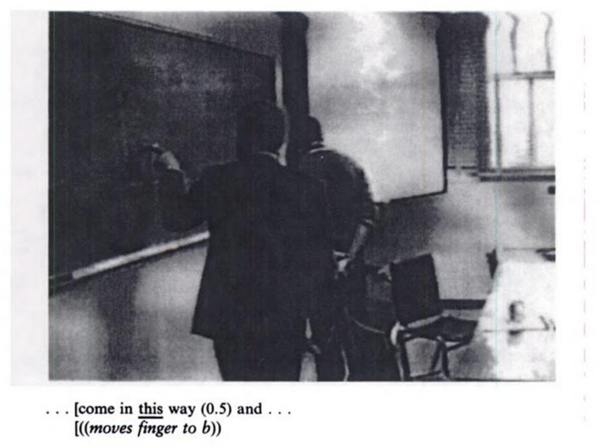
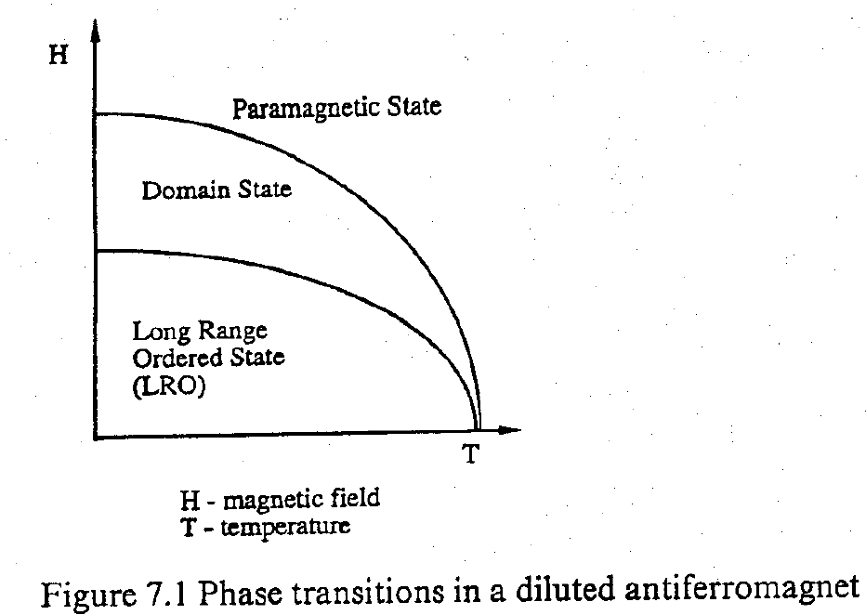
Physics Research Group Scenario: "When I come down I'm in the domain state"
Particle physicists in the lab are theorizing about their phenomena at the board. One of the physicists metaphorically projects himself into the sketched theoretical model of the phenomena—imagining himself to be a particle—as a way to clarify his thinking to others in the research group.
Hint: What intellectual work is being done by the scientist when he “projects” himself into the theory space?
Ochs, E., Gonzales, P., & Jacoby, S. (1996). "When I come down I'm in the domain state...": Grammar and Graphic Representation in the Interpretive Activity of Physicists. In E. Ochs, E. Schegloff, & S. Thompson (Eds.), Interaction and Grammar (pp. 328-369). New York: Cambridge.
Notes:
This one is about scientists making sense of phenomena…
((READ THE SCENARIO; SEE IF PEOPLE NEED ANY CLARIFICATION))
At your tables, look for evidence of each kind of sense-making resource you see.
((AFTER A MINUTE OR SO, CLICK TO REVEAL THE CLUE TO THE ROOM))
((START DEBRIEFING WITH THE ROOM ABOUT THE SENSE-MAKING RESOURCES THEY IDENTIFIED))
((TRANSITION TO NEXT SLIDE TO FULLY DEBRIEF))
[estimated time: 5-8 min]

Slide 37
Physics Research Group Scenario: "When I come down I'm in the domain state” What resources do you see evidence of?
Resources for Sensemaking:
imaginative perspective-taking (“becoming the particle”)
creative, collaborative theorizing around a diagram
gestures + talk used for communication
Pedagogical Implications:
In school, we often focus on “cleaned up” accounts of science investigations—and not on the creative, messy, and ambiguous process used to get there as theoretical ideas and processes get worked out.
Ochs, E., Gonzales, P., & Jacoby, S. (1996). "When I come down I'm in the domain state...": Grammar and Graphic Representation in the Interpretive Activity of Physicists. In E. Ochs, E. Schegloff, & S. Thompson (Eds.), Interaction and Grammar (pp. 328-369). New York: Cambridge.
Notes:
((CLICK TO SHOW QUESTION, SOLICIT RESPONSES FROM THE ROOM ABOUT RESOURCE))
((CLICK TO SHOW & DISCUSS RESOURCES))
((CLICK TO SHOW & DISCUSS CONNECTIONS TO PRACTICE))
[estimated time: 4 min]

Slide 38
The Salt Water Plant Experiment
An elementary school girl in Hawai‘i participated in a science fair and entered her science experiment on the conditions needed to support plant growth. As the result of climate change, ocean salt water is intruding into areas where native crops are grown in her community. She did a controlled comparison showing how taro plants respond to different concentrations of salt water. She received a low score from judges because she used a small number of taro plant samples. However, taro plants are sacred to her as ancestors and living relations of her Native Hawaiian cultural community, so she tried to minimize the number of taro plants that would be injured in her science experiment. She thought the sample size was adequate.
Hint: What can you say about the meaningful purpose she is bringing to her investigation? What plant knowledge does she have access to?
Lauren Kaupp, personal communication, 2018.
Notes:
((READ THE SCENARIO; SEE IF PEOPLE NEED ANY CLARIFICATION))
At your tables, look for evidence of each kind of sense-making resource you see.
((AFTER A MINUTE OR SO, CLICK TO REVEAL THE CLUE TO THE ROOM))
((START DEBRIEFING WITH THE ROOM ABOUT THE SENSE-MAKING RESOURCES THEY IDENTIFIED))
((TRANSITION TO NEXT SLIDE TO FULLY DEBRIEF))
[estimated time: 5-8 min]
[BACKGROUND: Here is background info related to this scenario]
http://ksdl2.ksbe.edu/loi/moolelo-kalo.html
http://www.kumukahi.org/units/ka_hikina/haloa
https://www.hawaiibusiness.com/native-hawaiian-culture-is-science/

Slide 39
The Salt Water Plant Experiment What resources do you see evidence of?
Resources for Sensemaking:
knowledge of local impacts of climate change / ecological reasoning
planning and conducting an ethical investigation
human-nature relations involving plant & animal kinships (Indigenous ontology)
Pedagogical Implications:
Her concerns for the ethical treatment of plants relate to a cultural value system that should be respected.
Instruction should be open to multiple scientific ways of knowing.
Notes:
((CLICK TO SHOW QUESTION, SOLICIT RESPONSES FROM THE ROOM ABOUT RESOURCE))
((CLICK TO SHOW & DISCUSS RESOURCES))
((CLICK TO SHOW & DISCUSS CONNECTIONS TO PRACTICE))
[estimated time: 4 min]

Slide 40
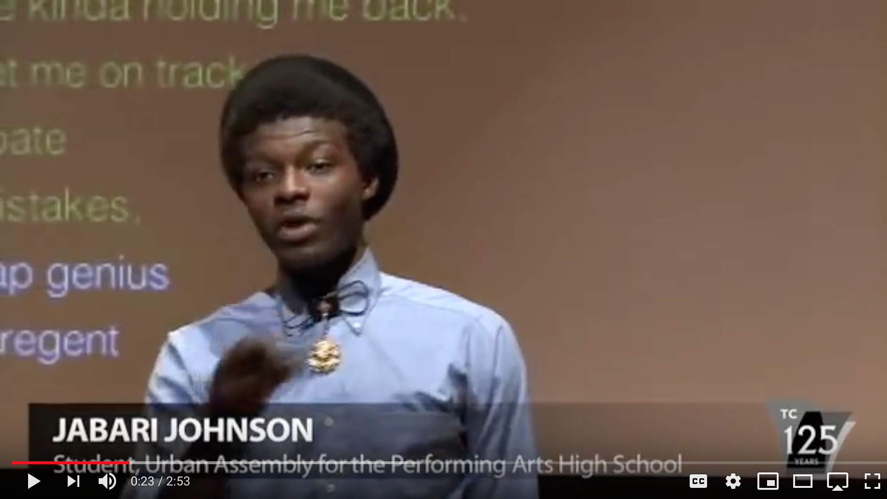
Hip Hop Science Explanations
Hint: What kinds of knowledge and expertise are involved with creating a rap that relates the physics principles of kinematics to everyday life?
See #HipHopEd on Twitter & NPR Story for more
Notes:
((SHOW THE VIDEO; SEE IF PEOPLE NEED ANY CLARIFICATION))
(( VIDEO URL: https://www.youtube.com/watch?v=959aWmNsjUs ))
At your tables, look for evidence of each kind of sense-making resource you see.
((AFTER A MINUTE OR SO, CLICK TO REVEAL THE CLUE TO THE ROOM))
((START DEBRIEFING WITH THE ROOM ABOUT THE SENSE-MAKING RESOURCES THEY IDENTIFIED))
((TRANSITION TO NEXT SLIDE TO FULLY DEBRIEF))
[estimated time: 5-8 min]

Slide 41
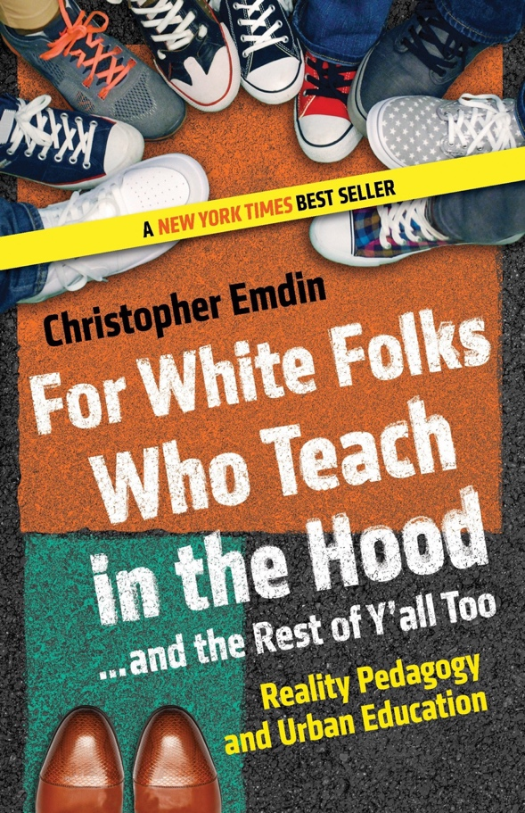
Hip Hop Science Explanations What resources do you see evidence of?
Resources for Sensemaking:
musical literacy for communication
conceptual science ideas
everyday reasoning about personal life
Pedagogical Implications:
What science learning might be involved with communication performances?
How might this support science identity development?
Notes:
((CLICK TO SHOW QUESTION, SOLICIT RESPONSES FROM THE ROOM ABOUT RESOURCE))
((CLICK TO SHOW & DISCUSS RESOURCES))
((CLICK TO SHOW & DISCUSS CONNECTIONS TO PRACTICE))
[estimated time: 4 min]

Slide 42
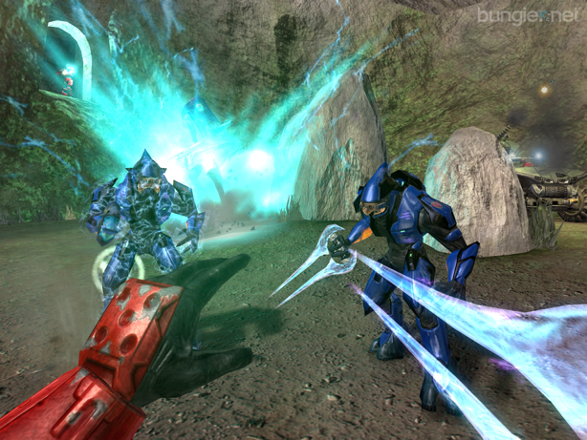
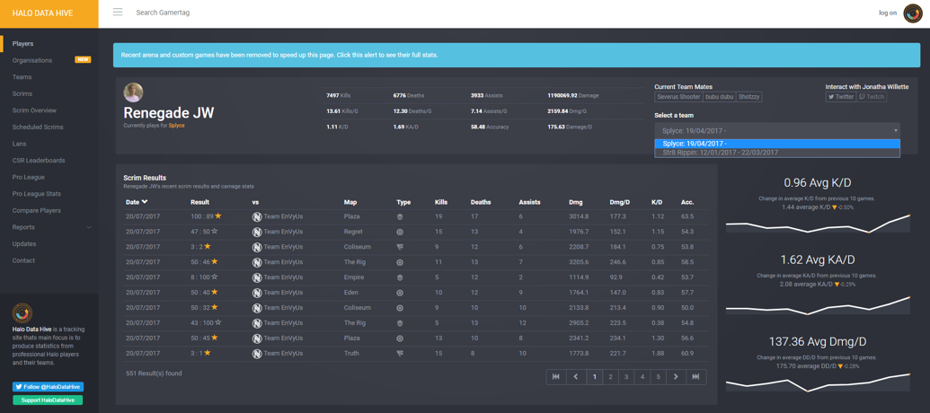
The LAN Videogame Party Scenario
It is several days before Steve’s 10th birthday, and his family will be throwing a “LAN party” for him, his friends, and other family friends where they will play his favorite multiplayer videogame (Halo) against each other. Steve is pouring over the player profiles and analytics of the people coming to the party which are represented through various graphs and statistics. He spends hours analyzing their game-time preferences and stats while developing strategies for how he can beat them during the party.
Hint: How does fluency with data analysis relate to science investigations? Is he constructing predictive models of human behavior?
Bricker, L. A., & Bell, P. (2012). “GodMode is his video game name”: Situating learning and identity in structures of social practice. Cultural Studies of Science Education, 7(4), 883-902.
Notes:
((READ THE SCENARIO; SEE IF PEOPLE NEED ANY CLARIFICATION))
At your tables, look for evidence of each kind of sense-making resource you see.
((AFTER A MINUTE OR SO, CLICK TO REVEAL THE CLUE TO THE ROOM))
((START DEBRIEFING WITH THE ROOM ABOUT THE SENSE-MAKING RESOURCES THEY IDENTIFIED))
((TRANSITION TO NEXT SLIDE TO FULLY DEBRIEF))
((BACKGROUND: People may ask if it is ethical for a 10 year old playing this videogame. This comes from a field study of family life. It happened, but that does not mean that it is recommended.))
[estimated time: 5-8 min]

Slide 43
The LAN Videogame Party Scenario What resources do you see evidence of?
Resources for Sensemaking:
time-series data analysis
probabilistic reasoning about data trends
predictive modeling with strategic planning
Pedagogical Implications:
Many youth deeply engage in videogaming with sustained design, analysis, sustained problem solving, and sometimes programming.
How can this expertise be leveraged?
Bricker, L. A., & Bell, P. (2012). “GodMode is his video game name”: Situating learning and identity in structures of social practice. Cultural Studies of Science Education, 7(4), 883-902.
Notes:
((CLICK TO SHOW QUESTION, SOLICIT RESPONSES FROM THE ROOM ABOUT RESOURCE))
((CLICK TO SHOW & DISCUSS RESOURCES))
((CLICK TO SHOW & DISCUSS CONNECTIONS TO PRACTICE))
[estimated time: 4 min]

Slide 44
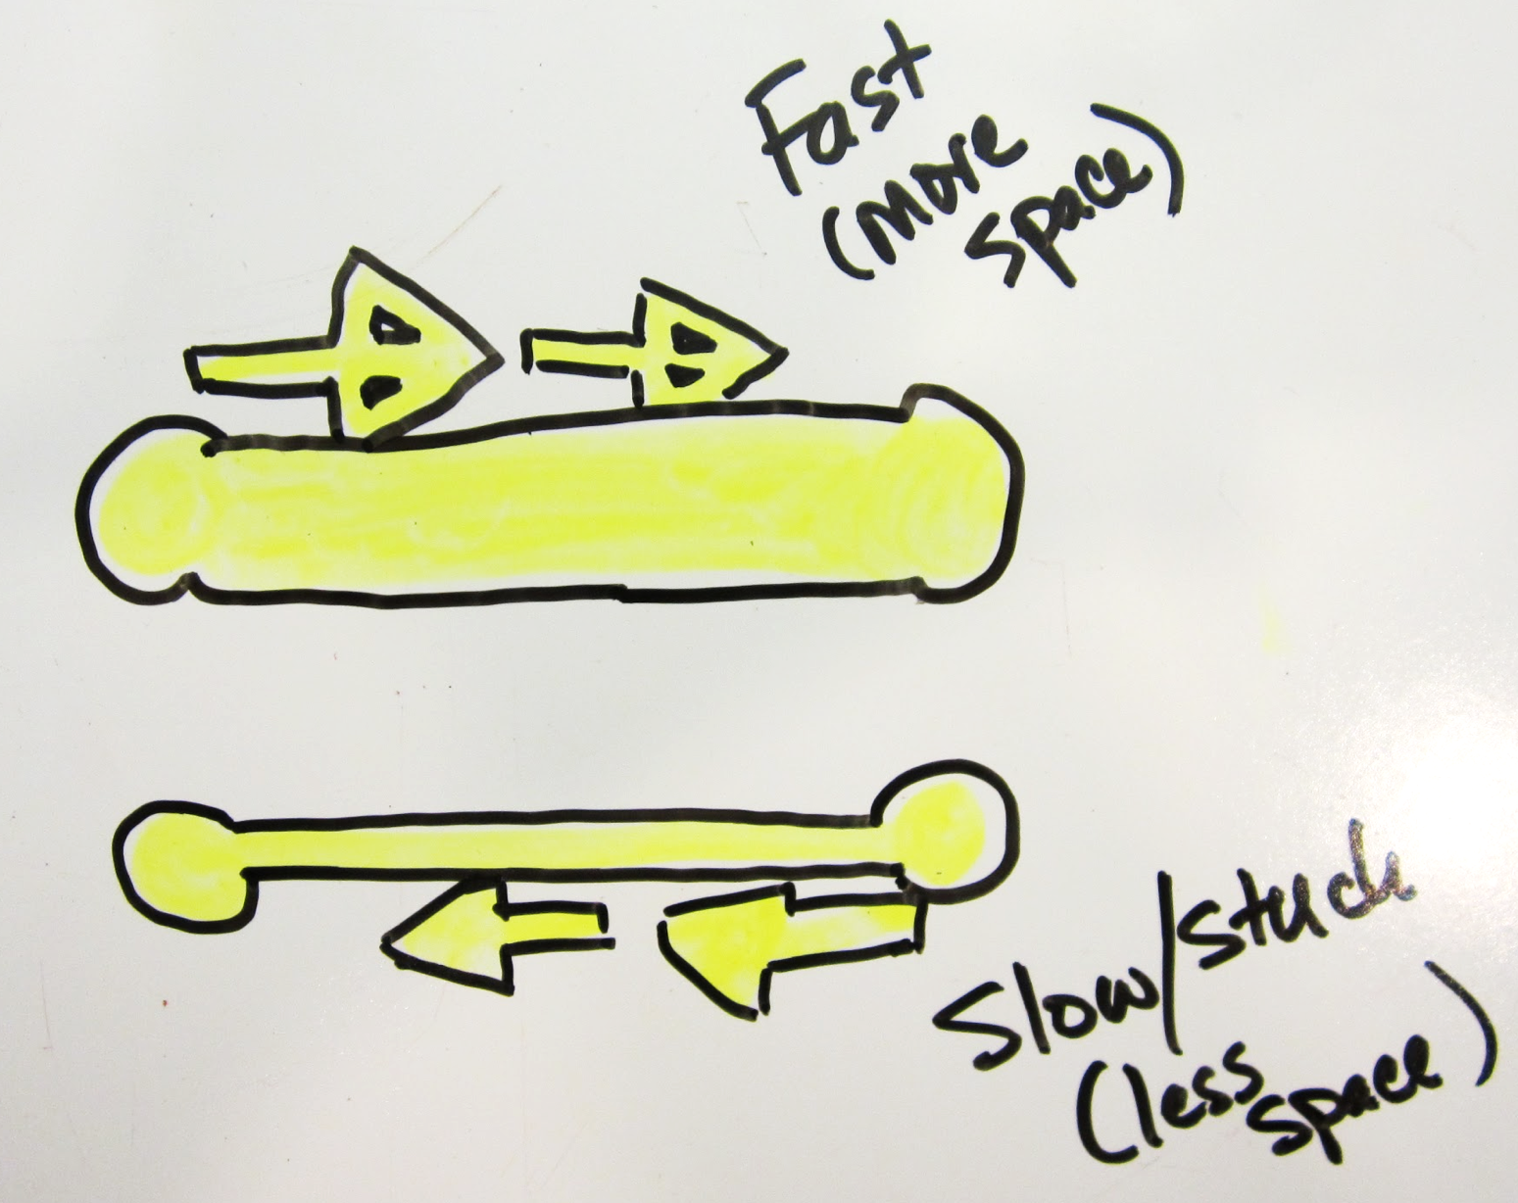
The Temporal Electricity Scenario
Yesenia’s explanation:
“La energía puede ir más rápido en este lado que en este lado… porque está muy chiquito y hay menos espacio para que la electricidad vaya, y aquí hay más espacio. Entonces está más fácil que vaya acá; pero a veces se atora aquí y no puede volver a la batería.”
[The energy can go faster on [wide conductor] than on this side [thin conductor] because it [thin conductor] is very small and there is less space for the electricity to go, and here [wide conductor] there is more space. So, it is easier for it to go here [wide conductor], but sometimes it gets stuck here [thin conductor] and it can’t go back to the battery.]
Using conductive ink, fourth grade students were investigating how altering the length and width of a conductor changes its resistance and, therefore, the brightness of a lamp connected to the circuit. Yesenia, a Latina student who was Spanish-English bilingual, observed that the lamp was brighter when connected to a circuit with wide conductive lines. In her reasoning she used the Spanish verb “estar”—which refers to a temporal state of being—to describe what was happening with the electricity as it experienced resistance. She did not use the verb “ser” which which refers to a permanent state of being. This suggests that Yesenia was aware of the temporal nature of electrical phenomena, rather than thinking of electricity as a permanent steady-state.
Hint: How does the diagram support the representation of her model for the phenomena? Why does it matter that she uses the temporary state of “to be” for electricity?
Suárez, E. A. (2017). Designing Science Learning Environments that Support Emerging Bilingual Students to Problematize Electrical Phenomena. (Unpublished doctoral Dissertation). University of Colorado, Boulder, CO.
Notes:
((READ THE SCENARIO; CLICK TO SHOW THE DIAGRAM; CLICK TO REVEAL THE DETAILED EXPLANATION; SEE IF PEOPLE NEED ANY CLARIFICATION))
At your tables, look for evidence of each kind of sense-making resource you see.
((AFTER A MINUTE OR SO, CLICK TO REVEAL THE CLUE TO THE ROOM))
((START DEBRIEFING WITH THE ROOM ABOUT THE SENSE-MAKING RESOURCES THEY IDENTIFIED))
((TRANSITION TO NEXT SLIDE TO FULLY DEBRIEF))
[estimated time: 5-8 min]

Slide 45
The Temporal Electricity Scenario What resources do you see evidence of?
Resources for Sensemaking:
making sense through material construction
conceptual resource in linguistic repertoire
talk + diagrammatic representation of model
Pedagogical Implications:
How can diagramming be used to support more equitable expression of understanding (e.g., conceptual models)?
How can you support students in using their full linguistic repertoire in their sensemaking?
Suárez, E. A. (2017). Designing Science Learning Environments that Support Emerging Bilingual Students to Problematize Electrical Phenomena. (Unpublished doctoral Dissertation). University of Colorado, Boulder, CO.
Notes:
((CLICK TO SHOW QUESTION, SOLICIT RESPONSES FROM THE ROOM ABOUT RESOURCE))
((CLICK TO SHOW & DISCUSS RESOURCES))
((CLICK TO SHOW & DISCUSS CONNECTIONS TO PRACTICE))
[estimated time: 4 min]

Slide 46
Expressing Knowledge Through Action Scenario
A third grade classroom investigated different types of apples with the focal question: “Does the type of apple affect girth?”. Instead of a single tool for measurement, students were provided a tape measure, string, yarn, and different colored pipe cleaners. One student worked with pipe cleaners to developed his own action-centered process and taped the pipe cleaner to paper to create a bar graph.
I measured the girth of 90 apples.
30 Golden Delicious, 30 Johnee, and 30 Empire
Step 1. I put tape on the 30 Golden Delicious apples.
Step 2. I put the numbers 1–30 on the apples.
Step 3. I punched out 30 small apples out of paper.
Step 4. I numbered the paper apples 1–30.
Step 5. I glued them in a line at the bottom of two pieces of construction paper.
Step 6. I taped one end of the pipe cleaner to the apple. I put the pipe cleaner around the middle of the apples like a belt.
Step 7. I marked the pipe cleaner where they touched.
Step 8. I cut it where they touched.
Step 9. I taped cleaners to the chart.
Britsch, S. J., & Heise, K. A. (2006). One Mode Is Not for All. Science and Children, 43(4), 26–29.
Notes:
((READ THE SCENARIO; SEE IF PEOPLE NEED ANY CLARIFICATION))
At your tables, look for evidence of each kind of sense-making resource you see.
((AFTER A MINUTE OR SO, CLICK TO REVEAL THE CLUE TO THE ROOM))
((START DEBRIEFING WITH THE ROOM ABOUT THE SENSE-MAKING RESOURCES THEY IDENTIFIED))
((TRANSITION TO NEXT SLIDE TO FULLY DEBRIEF))

Slide 47
Expressing Knowledge Through Action Scenario What resources do you see evidence of?
Resources for Sensemaking:
Action-centered processes
Creative methods of data collection and representation
Pedagogical Implications:
How can you provide flexibility in the data collection, representation and communication process?
Britsch, S. J., & Heise, K. A. (2006). One Mode Is Not for All. Science and Children, 43(4), 26–29.
Notes:
((CLICK TO SHOW QUESTION, SOLICIT RESPONSES FROM THE ROOM ABOUT RESOURCE))
((CLICK TO SHOW & DISCUSS RESOURCES))
((CLICK TO SHOW & DISCUSS CONNECTIONS TO PRACTICE))
[estimated time: 2 min]

Slide 48
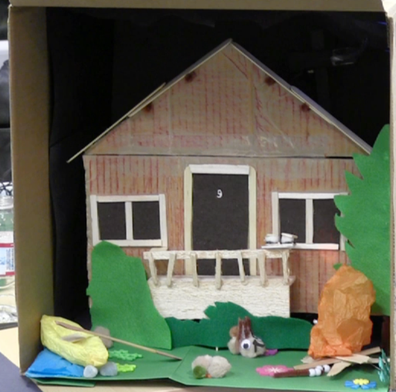
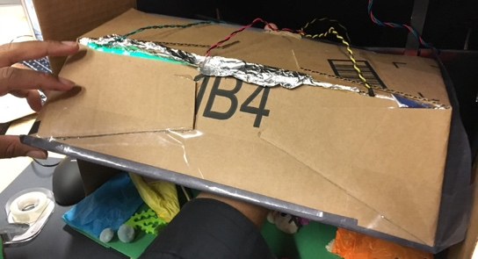
The Family Robotics Scenario
A family in a robotics program are designing an animated diorama—using microprocessors, actuators, and sensors—to convey a deeply meaningful family story about when they went camping in a cabin. The five year old daughter does not appear to be centrally engaged. As they discuss options she puts a cardboard frame on a computer screen showing a galaxy image to help her family conceptualize a starry night sky element and then starts building pieces of it. Her father starts building a reflective “star cage” using three LEDs to illuminate stars on a large black field (like a Lite Brite). The eight year old son starts programming the LEDs to gently twinkle. They co-develop it across interations.
Hint: Are most complex projects (e.g., in the workplace) accomplished by individuals or groups? How does that work? How did the daughter shape the final design?
Tzou, C., Bang, M. & Bell, P. (2017, April). Tech Tales: Connecting Robotics with Family Storytelling. Presentation at National Association of Research in Science Teaching (NARST) Annual Conference, San Antonio, TX.
Notes:
((READ THE SCENARIO; SEE IF PEOPLE NEED ANY CLARIFICATION))
At your tables, look for evidence of each kind of sense-making resource you see.
((AFTER A MINUTE OR SO, CLICK TO REVEAL THE CLUE TO THE ROOM))
((START DEBRIEFING WITH THE ROOM ABOUT THE SENSE-MAKING RESOURCES THEY IDENTIFIED))
((TRANSITION TO NEXT SLIDE TO FULLY DEBRIEF))
[estimated time: 5-8 min]

Slide 49
The Family Robotics Scenario What resources do you see evidence of?
Resources for Sensemaking:
problem framing and exploration
science-based, collaborative design (ideation, negotiation)
developing solutions through iterations and optimizing
Pedagogical Implications:
How can you support collaborative project work that both leverages learner expertise but also gets them to learn new things over time?
Tzou, C., Bang, M. & Bell, P. (2017, April). Tech Tales: Connecting Robotics with Family Storytelling. Presentation at National Association of Research in Science Teaching (NARST) Annual Conference,
San Antonio, TX.
Notes:
((CLICK TO SHOW QUESTION, SOLICIT RESPONSES FROM THE ROOM ABOUT RESOURCE))
((CLICK TO SHOW & DISCUSS RESOURCES))
((CLICK TO SHOW & DISCUSS CONNECTIONS TO PRACTICE))
[estimated time: 4 min]

Slide 50
And there are others…
Reflection How else do your students spend their time making sense of the phenomena in their world?
Notes:
And there are other kinds of resources students bring to bear…
Stories and experiences
Ways of building artifacts or crafting media
Sensory feelings they associate with specific natural phenomena
((STOP AND HAVE INDIVIDUALS REFLECT FOR A MOMENT BEFORE MOVING ON TO THE NEXT ACTIVITY))
[estimated time: 4 min]

Slide 51
Write Your Own Scenario
What other learning situation do you know about that helps us understand how students make sense of phenomena in an asset-based way.
Individually brainstorm some possibilities by thinking of particular situations that were striking to you.
Working in small groups, share and select one or two to share with the broader group. Write out a brief 4-5 sentence account of it, highlighting or showing evidence of the sense-making process.
Notes:
((READ THE SLIDE AND ENGAGE THE GROUP IN WRITING A SCENARIO USING BUTCHER PAPER OR A SHARED DOCUMENT))
[estimated time: 15-20 min]

Slide 52
Write Your Own Scenario What resources do you see evidence of?
Resources for Sensemaking:
Summarize what features of the sense-making you have evidence of in your scenario
Pedagogical Implications:
Describe significant pedagogical implications of your scenario.
Notes:
((READ THE SLIDE AND ENGAGE THE GROUP IN ELABORATING THE THINKING AROUND THEIR SCENARIO))
((WORKSHOP THE DEVELOPED SCENARIOS IN THE ROOM.))
[estimated time: 20-30 min]

Slide 53
Making a Plan to Develop Your Interpretive Power, or: Taking an Asset-Based Approach to Cultural Diversity
Notes:
Based on what we have learned about the diverse resources students bring to sensemaking, let’s develop an action plan for how to shift our practice.
[estimated time: 1 min]

Slide 54
Building Your Interpretive Power
“Interpretive power refers to teachers’ attunement to (a) students’ diverse sense-making repertoires as intellectually generative in science, and (b) expansive pedagogical practices that encourage, make visible, and intentionally build on students’ ideas, experiences, and perspectives on scientific phenomena” (page 1).
Rosebery, A., Warren, B., & Tucker-Raymond, E. (2015). Developing interpretive power in science teaching. Journal of Research in Science Teaching, 53(10), 1571-1600.
Notes:
Educational researchers Ann S. Rosebery, Beth Warren, and Eli Tucker-Raymond have a concept to describe the form of teacher expertise we have been developing. They call it “interpretive power.”
((READ SLIDE))
Let’s revisit the principles that help map out this interpretive power expertise…
[estimated time: 2 min]
[BACKGROUND CITATION]
Rosebery, A., Warren, B., & Tucker-Raymond, E. (2015). Developing interpretive power in science teaching. Journal of Research in Science Teaching, 53(10), 1571-1600. doi:10.1002/tea.21267

Slide 55
Three principles towards more equitable science education
Principle 1: Notice sense-making repertoires. Consider students’ diverse sense-making as connecting to science practices.
Principle 2: Support sense-making. Support students to use their sense-making repertoires and experiences as critical tools in engaging with science practices.
Principle 3: Engage diverse sense-making. Students’ scientific practices and knowledge are always developing and their community histories, values, and practices contribute to scientific understanding and problem solving.
From: Bang, Brown, Calabrese Barton, Rosebery & Warren, Toward more equitable learning in science, In Helping students make sense of the world using next generation science and engineering practices, NSTA.
Notes:
((HANDOUT THE PRINCIPLES))
These are the three equity principles from the equity chapter in the NSTA practices book. They are a powerful set of general principles for expansive teaching.
((READ THE PRINCIPLES—PERHAPS JUST HEADINGS WITH VERBAL SUMMARIES OF THE DETAILS))
[estimated time 3 min]

Slide 56
Culturally Resurgent Pedagogy
Instruction can be culturally responsive by meaningfully connecting to the cultural lives of youth and their communities—their languages, literacies, knowledge, and practices.
It can also be a context for supporting the resurgence of the life-ways of cultural communities—by valuing and centering the languages, literacies, knowledge, practices, and worldviews of cultural communities (Bang & Medin, 2010; Lee & McCarty, 2017). Culturally resurgent pedagogy promotes cultural pluralism in society and promotes the rights of non-dominant communities.
Notes:
There are different approaches to culture-based pedagogy. Culturally relevant and responsive approaches are common. Culturally sustaining approaches are increasingly popular. We want to explore culturally resurgent pedagogy that supports the continuance of the life-ways of non-dominant communities.
((READ SLIDE))
[estimated time: 1 min]
[BACKGROUND CITATIONS]
Bang, M., & Medin, D. (2010). Cultural Processes in Science Education: Supporting the Navigation of Multiple Epistemologies. Science Education, 94(6), 1008-1026.
Lee, T. S., & McCarty, T. L. (2017). Upholding Indigenous Education Sovereignty Through Critical Culturally Sustaining/Revitalizing Pedagogy. In D. Paris & H. S. Alim (Eds.), Culturally Sustaining Pedagogies: Teaching and Learning for Justice in a Changing World (pp. 61-82). New York, NY: Teachers College Press.

Slide 57
Personal Reflection
What are some specific insights about the resources students bring to sense-making that occurred to you today? Make a quick list.
Notes:
((WAIT FOR INDIVIDUALS TO CREATE A BRIEF LIST OF INSIGHTS))
[estimated time: 3-5 min]

Slide 58
How can you learn to stop and recognize these different resources in moments of instruction? How can you cultivate a classroom learning community where they are welcome contributions? Instructional Strategy: Listen closely and “open up” one student’s thinking deeply. Don’t always popcorn! Once you have noticed these kinds of sense-making resources—from the repertoires of students—leverage them in making progress on science investigations Principle 1 → Principle 2 → Principle 3 It centers multiple ways of knowing and making
Notes:
In terms of the stance you should adopt, it is one that is generous and open to what students produce. You should develop a norm for the messiness and ambiguity that comes with sorting out complex, new ideas.
((READ SLIDE))
Once we learn to see diverse resources for sense-making, we need to learn how to leverage them in instruction—or how to let them “diffract” into our sense-making experience.
[estimated time: 2 min]

Slide 59
Expanding Relationships Among Students, Teachers & Science Practices
“The bottom line is, the more you show genuine intellectual and scientific interest in your students’ sense-making [of phenomena], the more you expand the space of possible relations among you, your students, and science.”
—Bang, Brown, Calabrese Barton, Rosebery & Warren (2017, p. 34)
Notes:
I want to remind us about a major take-away here. How can we work to have all of these different kinds of sense-making resources connected to science in meaningful ways that we continue to explore as a community—for the purposes of building relationships to each other and to science.
((READ SLIDE))
[estimated time 3 min]

Slide 60
Equity-oriented STEM education must promote a rightful presence for all students across the scales of justice. — Tan & Calabrese Barton (2017) Progress frequently involves de-settling systems associated with historical inequities (Bang, et al., 2012) — while imagining and resourcing expansive cultural learning pathways (Bell, et al., 2012).
Notes:
((READ THE FIRST SENTENCE))
All students must be ensured a sense of “belonging” in the learning environment—in STEM education. They should have a rightful presence to these learning experiences and knowledge.
Relevant scales of justice: racial, socioeconomic, gender, environmental, Indigenous sovereignty, sexual orientation, migration history, etc.
And there are important intersectionalities… e.g., being a woman of color in STEM education
The second idea here highlights that the institutions we work in are imperfect—there are systems, infrastructures, and routines that produce inequities. Working towards equity and justice means that we actively “de-settle” these sources of inequity.
Examples of things that need de-settling include: ((SELECT A FEW TO SHARE))
course pathways where there is implicit or explicit tracking that is unfair
curriculum may include exclusionary storylines or phenomena
pacing schedules may not make room for responsive instruction and genuine sense-making
adverse stereotypes might be embedded in the environment—communicating who can / can’t learn STEM
narrow expectations around how to talk or write
unfair assessments (e.g., privileging the use of written prestige English—over other languages or ways of representing understanding
And then in response, we need to work to create more expansive cultural learning pathways for youth. Equity discussions can sometimes frame critiques—but not think through possible ways to respond and support learning.
[estimated time: 3 minutes]

Slide 61
The Equity Stance of Seeing The Diverse Sense-Making Resources of Students
In terms of rightful presence, we should recognize and legitimize the ways of knowing that learners bring to make sense of phenomena
In terms of de-settling, we want to disrupt narrow ways of speaking, knowing, acting, and valuing when making sense of phenomena (e.g., known-answer questions, strict turn-taking)
We can extend cultural learning pathways by leveraging the sense-making resources of youth to help them develop a relationship to science and better identify with the endeavor—promote their sense of belonging
Notes:
So relating these equity dimensions to the work we have been doing in this session…
((READ SLIDE))
[estimated time: 2 minutes]

Slide 62
Making a Specific Commitment
From your list, identify one ‘take-away’ related to how you will respond to students’ contributions. What will you commit to try out in your practice to shift deeper into an asset-based view of sense-making? A possible prompt: “In order to _____, I will work to ______ , and I will know I am making progress if _____.
Notes:
Here’s the wrap up… based on the main take-away what is a concrete commitment you can make to have a more generous and open stance to the intellectual treasures (i.e., assets) that students share with you. This work takes some concerted effort to get going—but then it becomes routine.
((READ SLIDE, launch the reflection activity))
Reflect on a specific thing you’ve learned that relates to something you want to work on in your practice. Name it. Write it down. Put it somewhere where it will nudge you to keep working on it over time. And then move on to the next concrete commitment.
((Possible commitments (if people have a hard time generating them—or if you want to model what is intended:
In order to better attend to the diversity of student’s ideas, I will work to ask them to rephrase their connecting idea when I don’t understand it, and I will know I am making progress if I come to see the meaning behind the connection they are making.”
Twice per class period I will sink in and explore the depth of one student’s thinking—as opposed to popcorning around.
Ask more questions about their responses when I don’t understand the connection to science / our efforts.
To monitor how I respond on-the-fly to student ideas. Am I only seeking out what I believe is the “right” answer?
I will closely observe how students engage in activity and try to see how they engage in knowledge work—like with observation and story in the Indigenous brief.
I will use my interest in a student’s thinking every day to further develop a intellectual relationship with that student.))
((AFTER PEOPLE GENERATE THEIR COMMITMENTS, HAVE PEOPLE SHARE THEM.))
[ALTERNATIVE: You might ask participates to use a web site reminder system like https://www.futureme.org to send themselves a reminder in the future based on their specific commitment.]
[estimated time: 10 min]

Slide 63
Help us improve the resource Please take this 5 minute survey to help the ACESSE team improve this resource for others. https://tinyurl.com/ACESSEResourceG
Notes:
[READ SLIDE and ask participants to complete the survey. Clarify that this is information for the ACESSE team to refine the activities—and not about you as the facilitator.]
[estimated time: 5 min]

Slide 64
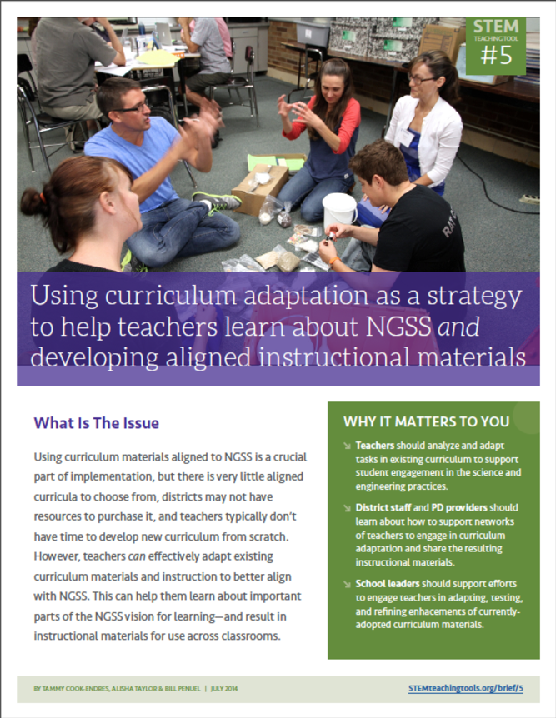
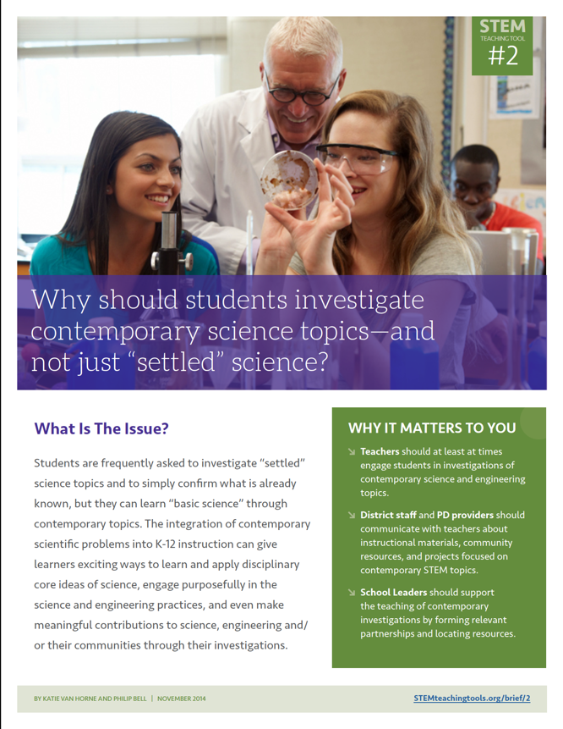
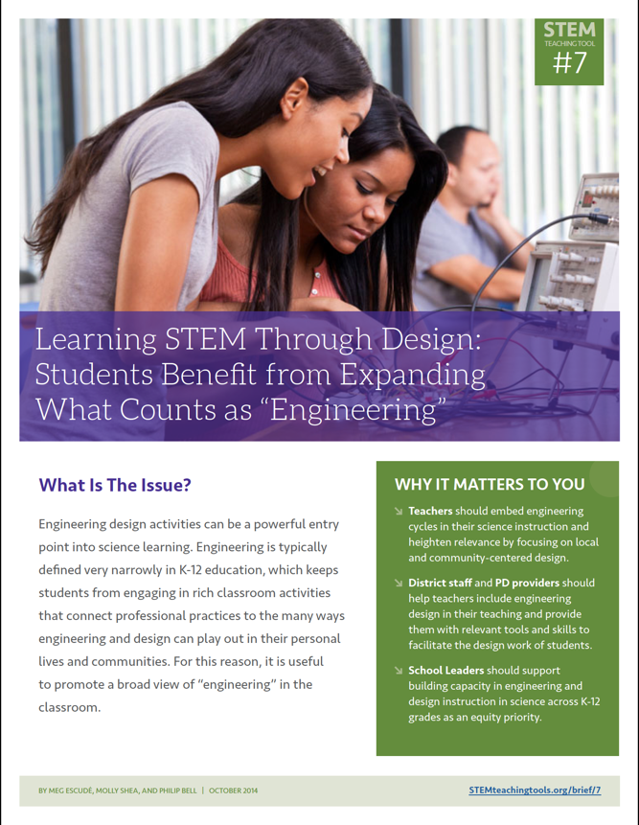
Professional Learning Resources to Support NGSS Implementation
Co-designed by practitioners & researchers
Tested & refined over time
Easily shareable—over social media, email, paper
STEMteachingtools.org (web)
@STEMteachtools (twitter)
pinterest.com/stemeducation (pinterest)
Notes:
You will be able to find ACESSE resources and other tools on the STEM Teaching Tools site. You can easily download PDFs of dozens of tools to support implementation of the NRC Framework vision.
[estimated time: 30 sec]

Slide 65
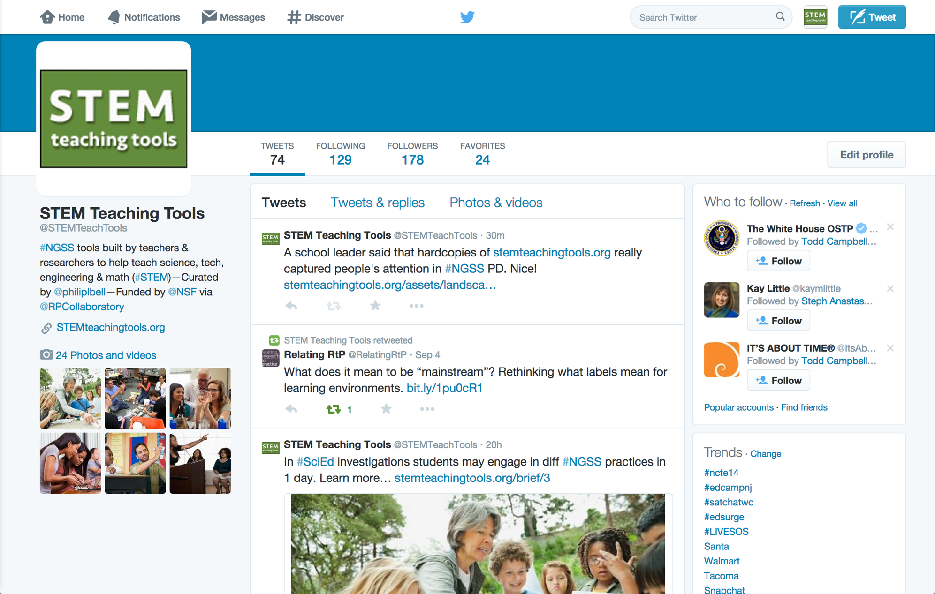
On Twitter @STEMTeachTools
Notes:
You can learn about these tools on Twitter.
[estimated time: 30 sec]

Slide 66
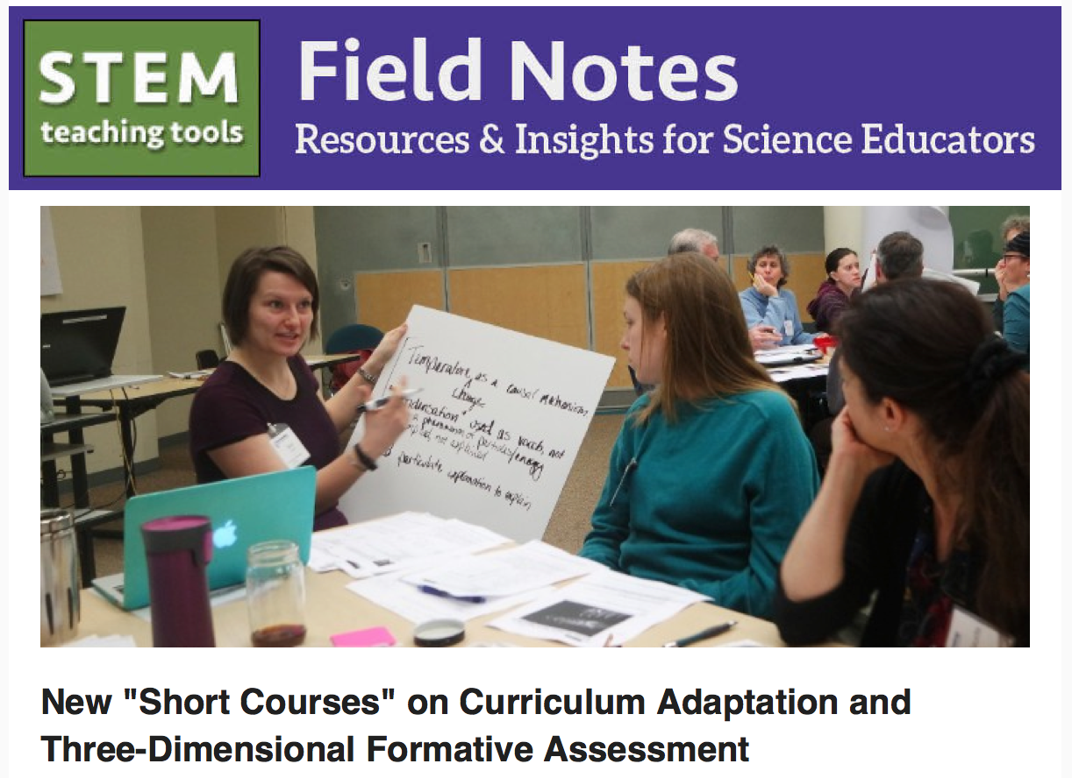
Sign Up for Email Newsletter STEMteachingtools.org
Notes:
Or sign up for a periodic email newsletter—at the bottom of the front page of the web site.
[estimated time: 30 sec]

Slide 67
IndigenousEducationTools.org
Notes:
Here’s a great set of tools focused on Indigenous pedagogy and ways of knowing. The tools are generally useful for all students.
[estimated time: 30 sec]

Slide 68
The authors want to express their deep gratitude to everyone in the ACESSE Network who provided feedback on this resource…
Kevin Anderson, June Apaza, Tammy Askeland-Nagle, Joanna Bruno, Melissa Campanella, Megan Cannon, Marianne Cappello, Mary Colson, Sarah Derry, Laura Downey, Ellen Ebert, Moises Esteban-Guitart, Ann Finch, Laura Grissom, Michael Heinz, Susan Holveck, Cora James, Kris Kilibarda, Heena Lakani, Maryellen Lechelt (Cervenak), Earl Legleiter, Max Longhurst, Catherine Mackey, Amber McCulloch, Stacy Meyer, Tiffany Neill, Michael O'Toole, John Olson, Doug Paulson, Candace Penrod, William Penuel, Cheryl Reiter, Meg Richard, Robbin Riedy, Jamie Rumage, Megan Schrauben, Ricky Scott, Tamara Smolek, Michele Snyder, Mary Starr, Cristina Trecha, Kerri Wingert, and Deb Wolf.
Notes:
This resource—along with all of the others from the ACESSE project—went through cycles of co-design, use, and refinement by researchers and practitioners working in science education. The authors wanted to acknowledge the contributors listed here.
[estimated time: 30 sec]
((This resource was refined through a 13-state collaboration to make the resource more broadly useful. If you choose to adapt these materials, please attribute the source and that it was work funded by the National Science Foundation (NSF).))

Slide 69
Thank you! For more info…
Resources
STEM Teaching Tools STEMteachingtools.org @STEMTeachTools (twitter)
Other ACESSE OER PD Modules STEMteachingtools.org/PD
Indigenous Education Tools IndigenousEducationTools.org
Contact Us
Philip Bell pbell@uw.edu @philiplbell
Megan Bang megan.bang@northwestern.edu @meganbang3
This resource was developed through the ACESSE project funded by the National Science Foundation (NSF) through Award DRL-1561300 and the Research + Practice Collaboratory funded by NSF through DRL-1626365. The opinions do not represent those of the funder.
Notes:
Here are some resources and contact information for the lead author of this PD unit. They hope you have found it useful. They welcome any feedback or suggestions on how to improve it.
[estimated time: 30 sec]
((This resource was refined through a 13-state collaboration to make the resource more broadly useful. If you choose to adapt these materials, please attribute the source and that it was work funded by the National Science Foundation (NSF).))

